Slide 1
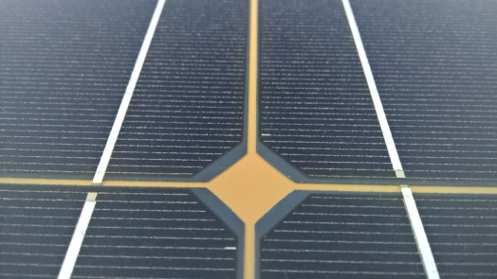
Announcement (2)
Structure
These program topics will be presented by experts and further developed in roundtable sessions and discussions.
Block 1: Reliability from science to finance
a) Reliability as a science
b) Latest standards developments > Toni Sample, JRC
c) Taking into account the value of reliability > Eward His, CFA
d) Eco label/design
Block 2: Bifacial Solar Modules
a) Operating temperature and performance testing of bifacial modules > Juan Lopez-Garcia, JRC
b) Reliability of clear backsheets for bifacial modules > Axel Borne, Dupont
c) Current market situation and challenges for bifacial modules
Block 3: BIPV & Reliability
a) Introductory Information on BIPV > Alessandro Virtuani, EPFL
b) Certification of BIPV: Requirements, Tests, Procedure > Luca Votta, KIWA
c) Certification of BIPV: Requirements, Tests, Procedure
d) Certification of BIPV: Requirements, Tests, Procedure
e) Current market situation and challenges for BIPV modules
f) Roundtable Session “BIPV” & Discussion
Block 4: SolarTrain: Materials, Climate, Performance evolution – Everything is connected
SolarTrain Post Graduates presenting their research topics and results:
a) Understanding the climate related operation conditions of PV systems
b) Advanced charcterization of PV materials: natural and artificial ageing
c) Testing and characterization of PV modules
d) Field performance losses and service life prediction
e) Moisture ingress in PV modules > Stefan Mitterhofer, Uni Ljubljana
Block 5: Integrated PV & novel applications
a) Floating PV
b) Reliability of flexible CIGS modules > Eleonora Annigoni, FLISOM
c) Lightweight PV modules for multiple applications > Fabiana Lisco, EPFL
Block 6: Recent technology developments and failure modes
a) SHJ, passivated contacts
b) LeTID > Daniel Philipp, ISE
c) Roundtable Session „Novel applications, technologies and testing requirements“ & Discussion
Block 7: Field experiences
a) Assessment of multiple PV systems' reliability in desert environment in Doha Qatar > Vinod Madhavan, QEERI
b) Field module characterization > Andrew Fairbrother, EPFL
c) Challenges of Operation and Maintenance
Final Roundtable session, discussion and sum up
Optional Block 8: Labtour at EPFL
10th SOPHIA Workshop PV-Module Reliability
May 28th – 29th, 2020,
EPFL École Polytechnique Fédérale de Lausanne, Neuchâtel, Switzerland
OBJECTIVES:
REquirements of new and upcoming PV applications for material selection and RELIABILITY ASSESSMENT
The École Polytechnique Fédérale de Lausanne EPFL (Switzerland) and the Fraunhofer Institute for Solar Energy Systems ISE (Germany) are proud to invite to the 2020 SOPHIA-workshop ‘PV-Module Reliability’ in Neuchâtel, Switzerland. The 2020 workshop will feature reliability aspects of innovative PV applications in service life prediction modelling and standardization. Aspects of the influence of reliability on sustainability will be presented and further information on the EU-Project SolarTrain provided.
This year’s topics of the workshop are:
Building Integrated PV (BIPV) With increasing regulatory pressure, such as the European nearly zero-energy building (NZEB) requirements, BIPV will play a significantly increasing role in energy systems. Their functional requirements and operational environment vary greatly from typical PV systems, and long-term performance is a critical matter.
Novel applications: special and innovative New applications of PV modules and systems like floating PV, street integrated PV or Agro-PV come along with specific operational conditions and loads. How do these effect reliability and how can the specific conditions be addressed?
Bifacial modules Bifacial modules are more and more present in the market and forecasts expect further growth of this technology in future. The special load conditions and related effects on materials and impacts on module reliability will be in the focus of this session.
Advancements in lifetime modelling How can reliability and degradation models be improved to predict the development of PV modules and plants?
Sustainability Interdependence of Reliability and Sustainability and legislative effects, including the outcomes of the EU EcoLabel preparatory study.
Recent failure mode testing Recent failure modes like LeTID call for adapted testing to be developed and validated.
Regular Registration fees : 430 EUR – Early Bird Discount until April 15th: 380 EUR
Registration fees for Students: 330 EUR – Early Bird Fee for Students until April 15th: 280 EUR
For more information and for registration please visit the workshop’s website:
www.pv-reliability.com
Workshop postponed!
New date and information will follow soon
Stay healthy!
Organizer
Fraunhofer ISE, Dr. Karl-Anders Weiß
Host
EPFL, Dr. Alessandro Virtuani
For questions please contact
karine.frossard@epfl.ch
kerstin.koerner-ruf@ise.fraunhofer.de

