Slide 1
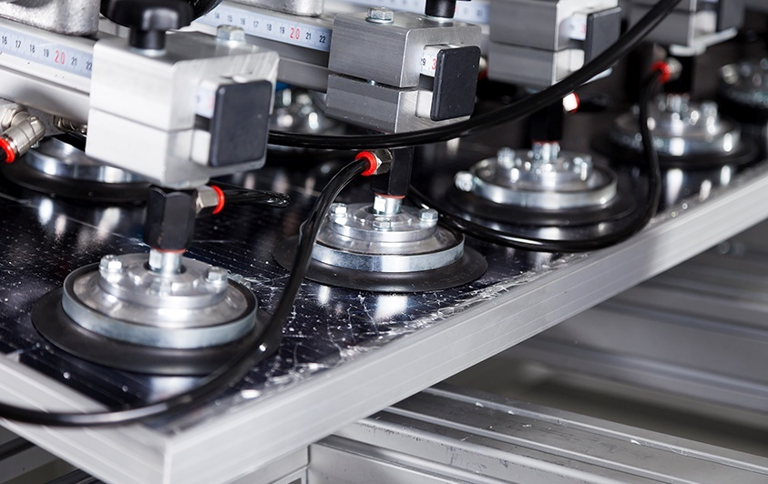

Mechanical Stability of PV Modules
  —
    Jochen Markert, Frank Ensslen, Tobias Rist, Enzo Job, Ingrid Hädrich and Daniel Philipp
    SOPHIA-Workshop, Hasselt, 26.04.2024

Slide 2
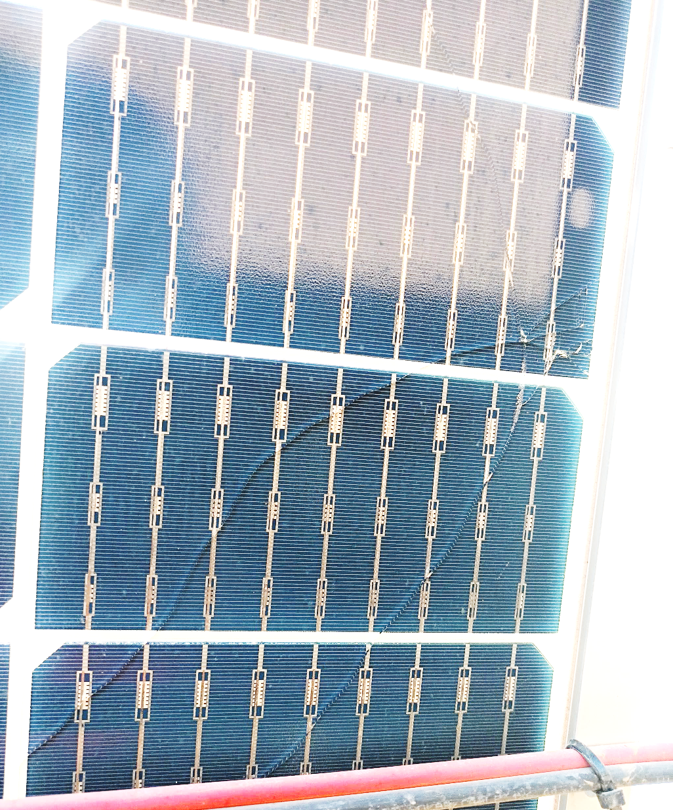
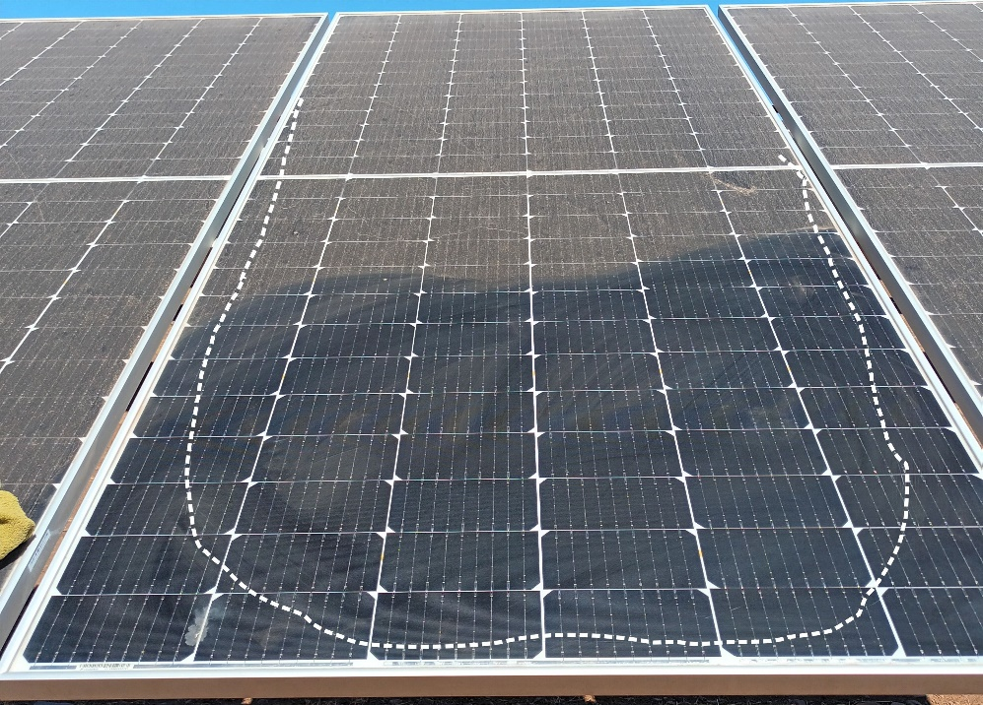
Motivation
Increased number of inquiries concerning glass breakages in PV power plants from all over the world
      Affected are:
        Framed/unframed modules in different mounting confidurations
        Module area > 2 m²
        Glass/glass designs with thicknesses ≤ 2.5 mm
  Crack path (traced)
      In contrast to mechanical failures in the past, problems occur after just a few months in the field

Slide 3
Motivation
Cause of Glass Breakage
Environmental Impact
Glass Breakage
Transport/ Handling
Assembly Error

Slide 4
Motivation
Cause of Glass Breakage
Environmental Impact
Glass Breakage
Transport/ Handling
Assembly Error

Slide 5
Motivation
Cause of Glass Breakage
Glass Thickness
Contradictory development in PV industry
      Trend towards larger modules with ever thinner glass
Trend to ≤ 2 mm
Module Area
Environmental Impact
Glass Breakage
Trend to ≥ 3 m²
Transport/ Handling
Assembly Error

Slide 6
Motivation
Cause of Glass Breakage
Glass Thickness
Glass as a brittle material seems to be a weak point in current module designs
Glass Quality
Trend to ≤ 2 mm
Module Area
Environmental Impact
Glass Breakage
Trend to ≥ 3 m²
Transport/ Handling
Assembly Error

Slide 7
Motivation
Cause of Glass Breakage
Glass Thickness
Glass quality
      Edge quality
      Defect density
      Bending strength
      Prestressing of glass
Glass Quality
Trend to ≤ 2 mm
Module Area
Environmental Impact
Glass Breakage
Trend to ≥ 3 m²
Transport/ Handling
Assembly Error

Slide 8
Motivation
Cause of Glass Breakage
Glass Thickness
Glass quality
      Edge quality
      Defect density
      Bending strength
      Prestressing of glass
Glass Quality
Trend to ≤ 2 mm
Module Area
Environmental Impact
Glass Breakage
Trend to ≥ 3 m²
Transport/ Handling
Assembly Error

Slide 9
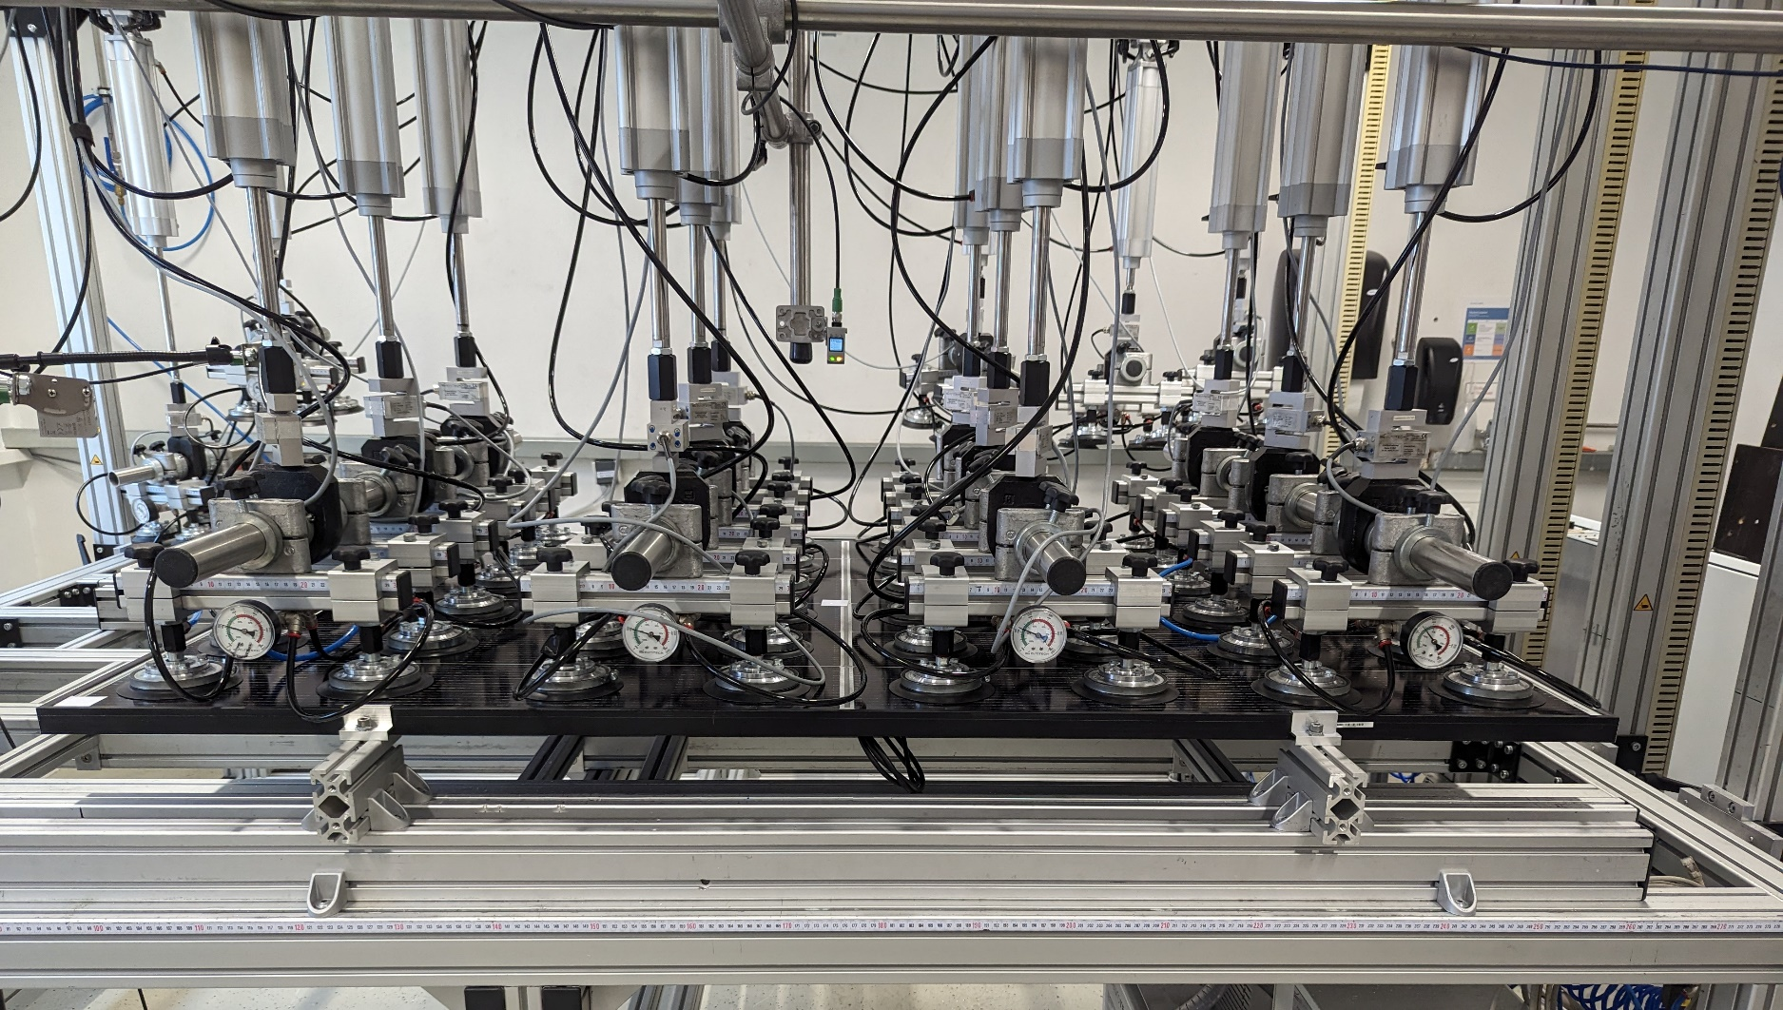
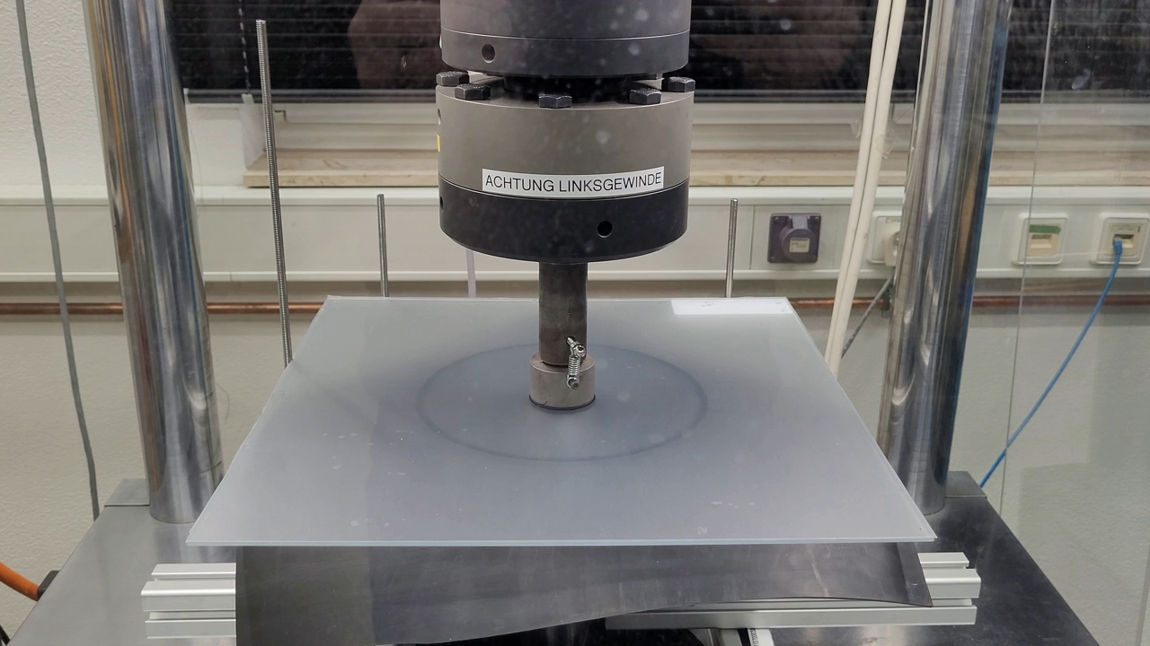
Qualification of Mechanical Stability
Glass- vs. PV-Industry
Glass-Industry
      Four-point- or double-ring-bending tests on a statistical relevant number of glass samples
PV-Industry
      Currently, a mechanical load test on a module in the certification process

Slide 10
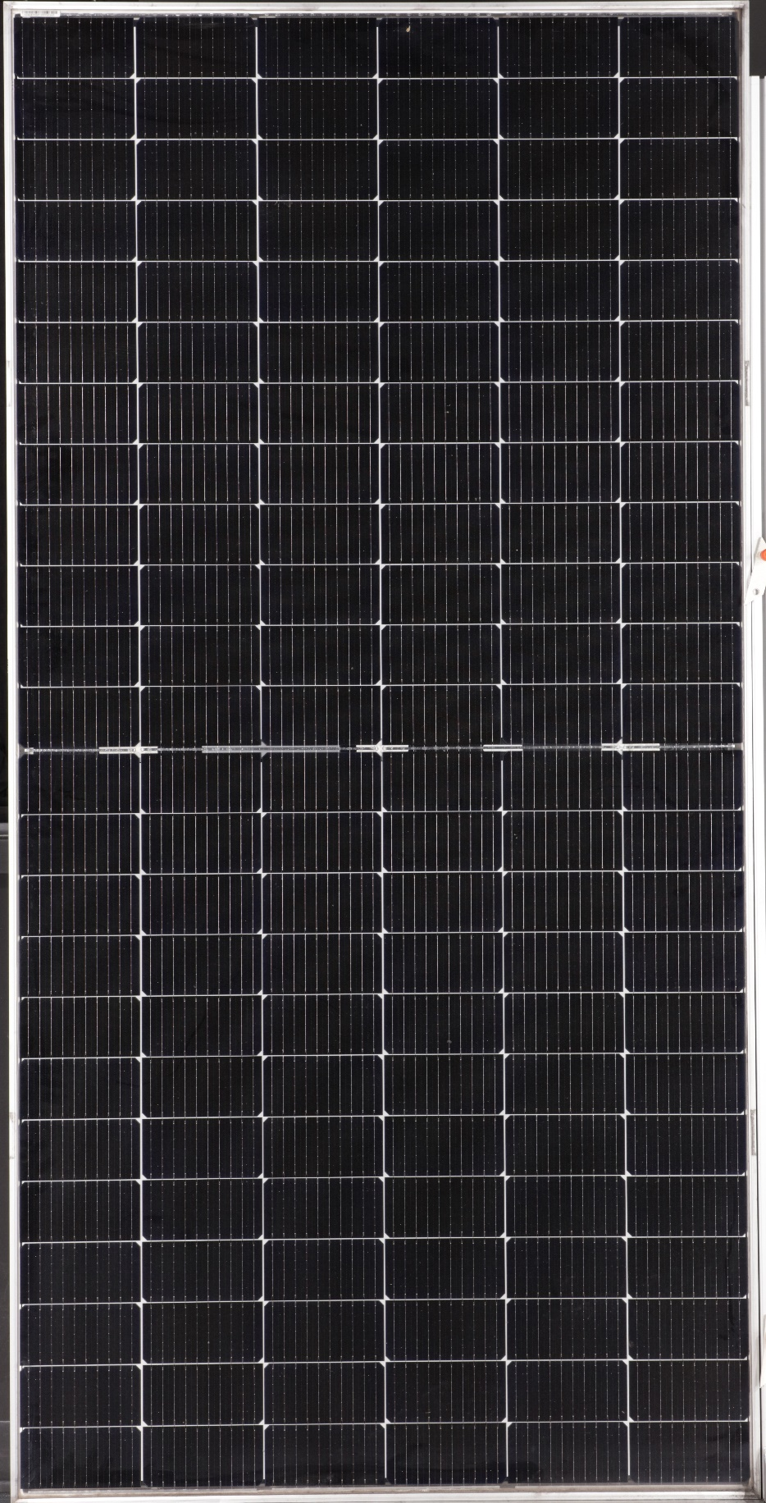
Glass Quality
Determination in PV Modules
Possible approaches:
      No direct determination (e.g. with 4-point-bending test) possible on laminate level

Slide 11
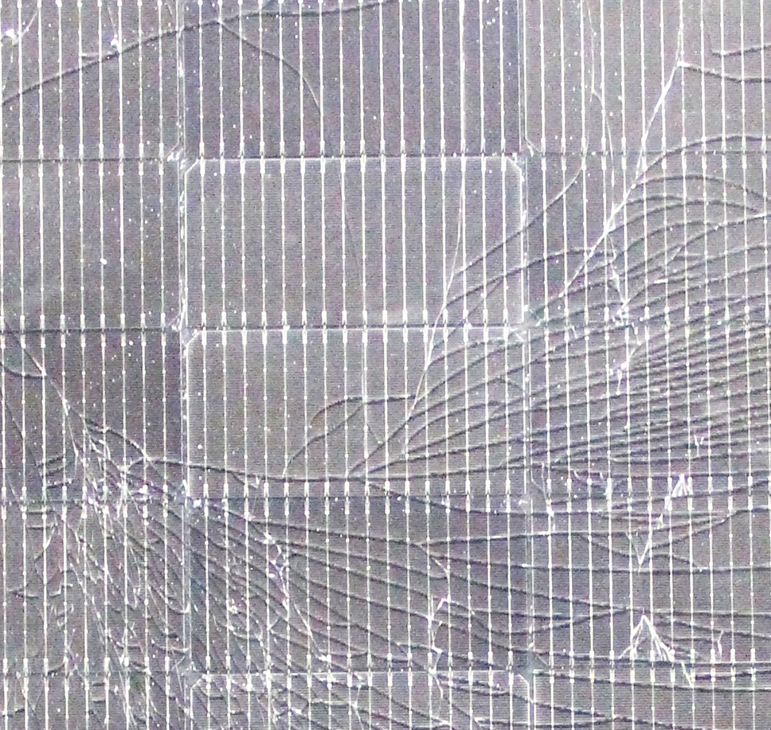
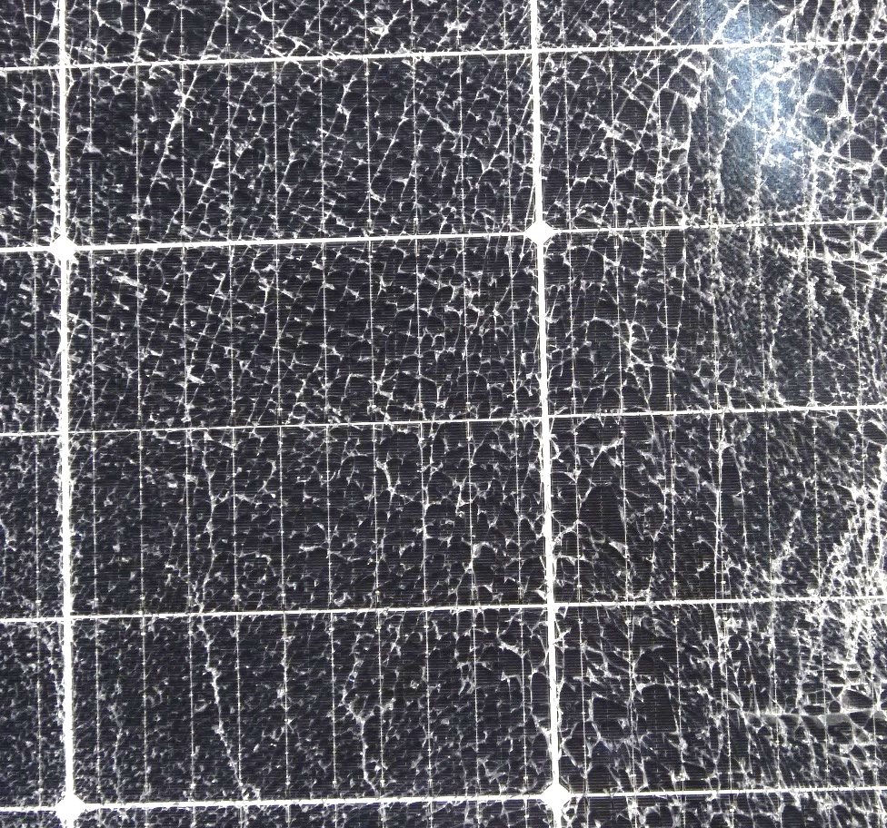
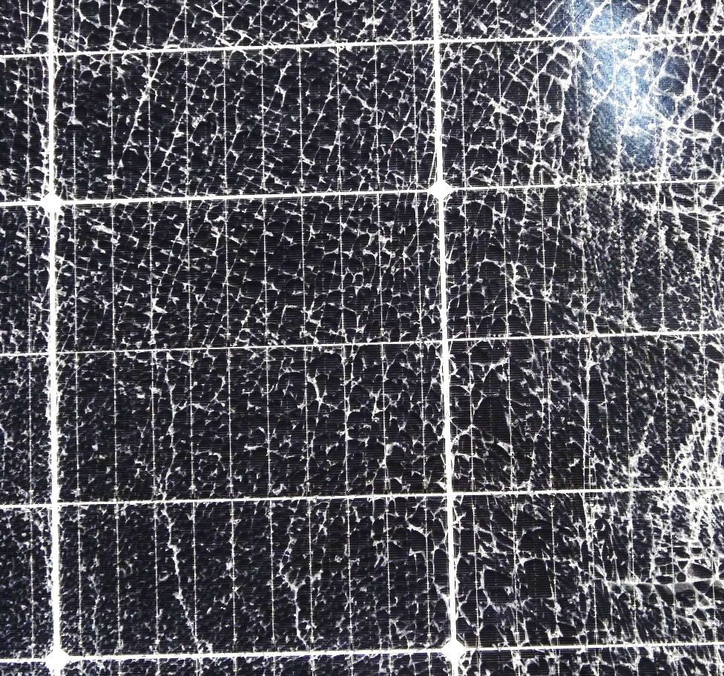
Glass Quality
Thermally Toughened Safety Glass (TTG) | Heat Strengthened Glass (HSG)
Homogeneous, fine-grained crack pattern | Inhomogeneous, coarse crack pattern with larger intact areas
Determination in PV Modules
Possible approaches:
      No direct determination (e.g. with 4-point-bending test) possible on laminate level
      Fracture patterns: Qualitative classification of glass quality
[1]
[1]
[1] Wagner, E. Glasschäden: Oberflächenbeschädigungen, Glasbrüche in Theorie und Praxis, 2020.

Slide 12
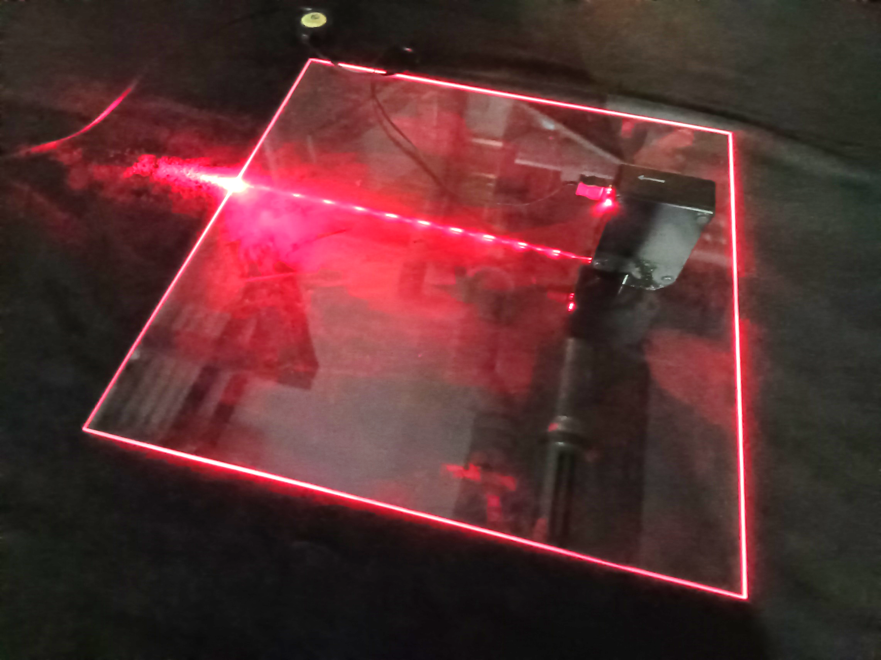
Glass Quality
Determination in PV Modules
Possible approaches:
      No direct determination (e.g. with 4-point-bending test) possible on laminate level
      Fracture patterns: Qualitative classification of glass quality
      Scattered light polariscope: Non-destructive measurement of the prestressing

Slide 13
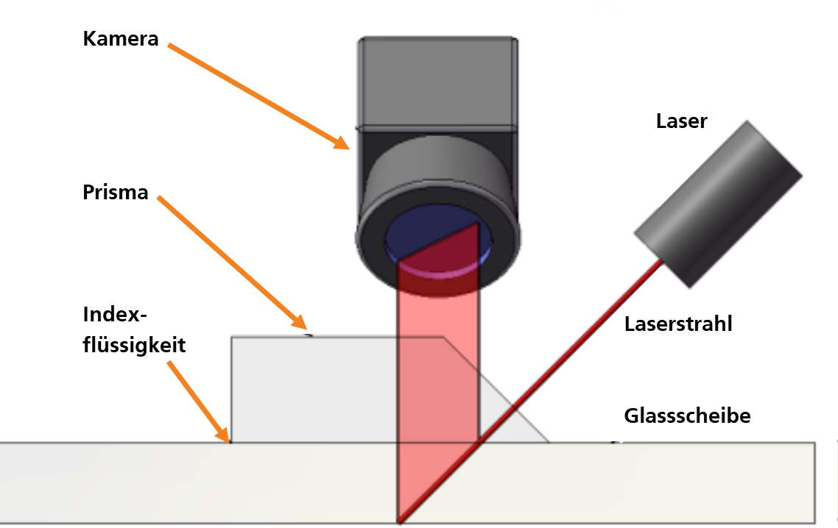
Glass Quality
Camera
Determination in PV Modules
Laser
Prism
Possible approaches:
      No direct determination (e.g. with 4-point-bending test) possible on laminate level
      Fracture patterns: Qualitative classification of glass quality
      Scattered light polariscope: Non-destructive measurement of the prestressing
Coupling
fluid
Laser beam
Glass pane
Prestressed Glass
Compressive stress
Tensile stress
Compressive stress

Slide 14
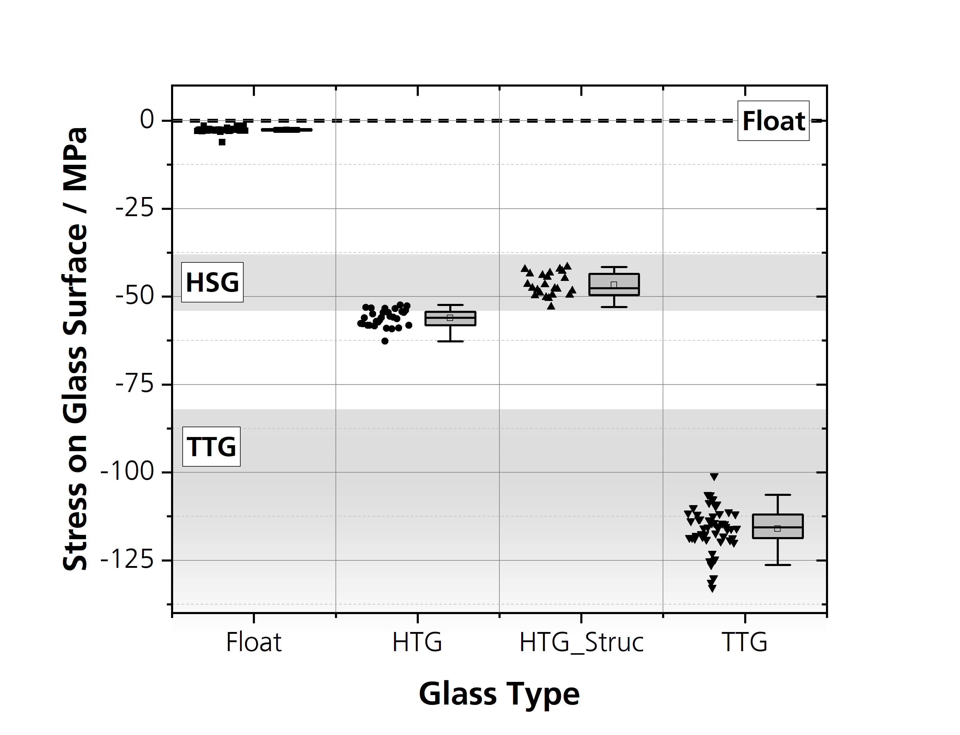
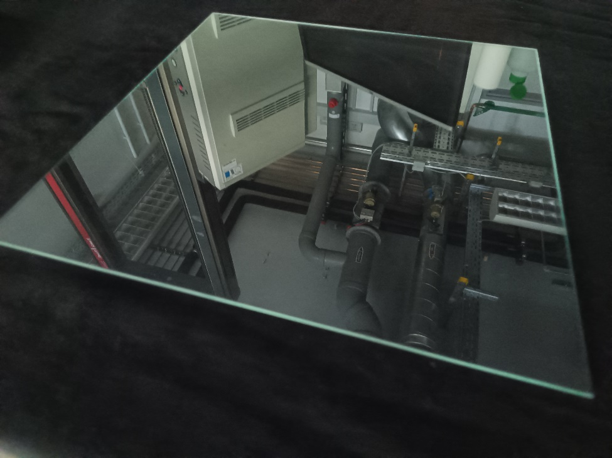
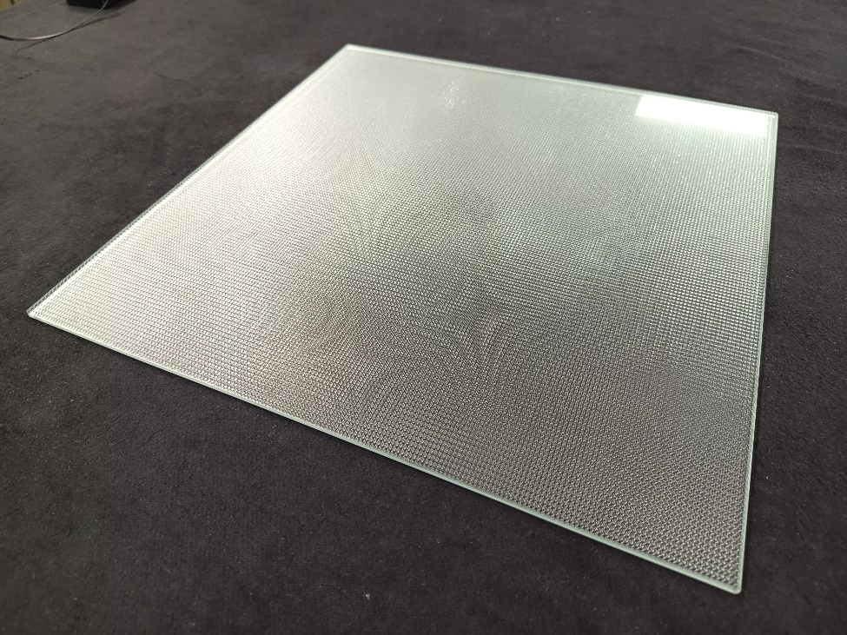
Results
Glass Samples – SCALP Measurements
SCALP Measurements
30 glass samples for each type (360 x 360 mm²)
      Float Glass, 3 mm
      HSG, 4 mm
      HSG structured, 4 mm
      TTG, 3mm

Slide 15
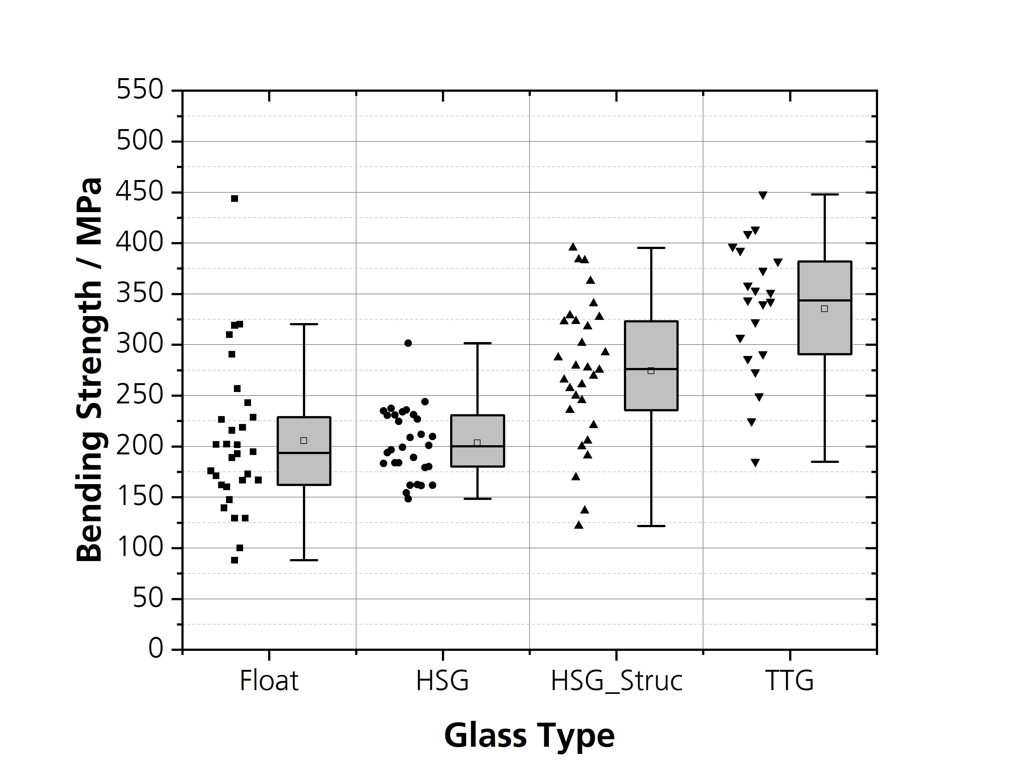
Results
Glass Samples – SCALP Measurements + Double-Ring-Bending Test
Double-ring-bending test
SCALP measurements

Slide 16
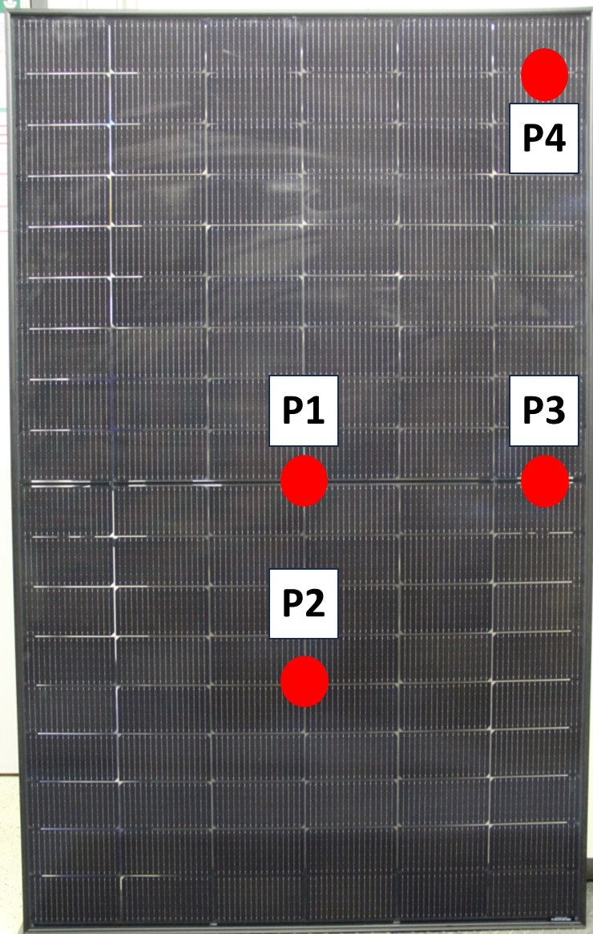
Results
PV Modules – SCALP Measurements
4 commercially available PV module types (~2 m²)
were investigated:
Module Type | PV Module Design | Glass Thicknesses / mm
Type 1 | Glas/Glas | 2.0 / 2.0
Type 2 | Glas/Glas | 1.6 / 1.6
Type 3 | Glas/Glas | 1.6 / 1.6
Type 4 | Glas/Backsheet (Ref.) | 3.2 / -.-

Slide 17
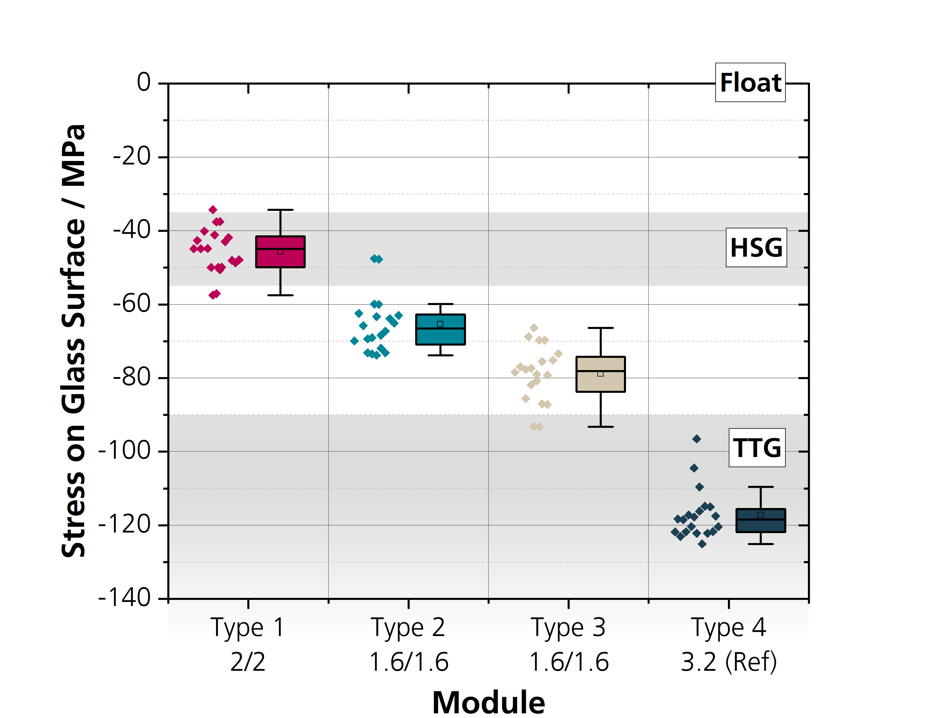
Results
PV Modules – SCALP Measurements
4 commercially available PV module types (~2 m²)
were investigated:
Module Type | PV Module Design | Glass Thicknesses / mm
Type 1 | Glas/Glas | 2.0 / 2.0
Type 2 | Glas/Glas | 1.6 / 1.6
Type 3 | Glas/Glas | 1.6 / 1.6
Type 4 | Glas/Backsheet (Ref.) | 3.2 / -.-
Measurement of the glass surface stress:
      Measurable differences could be observed in the panes
      1.6 mm glass with higher prestress than 2 mm glass

Slide 18
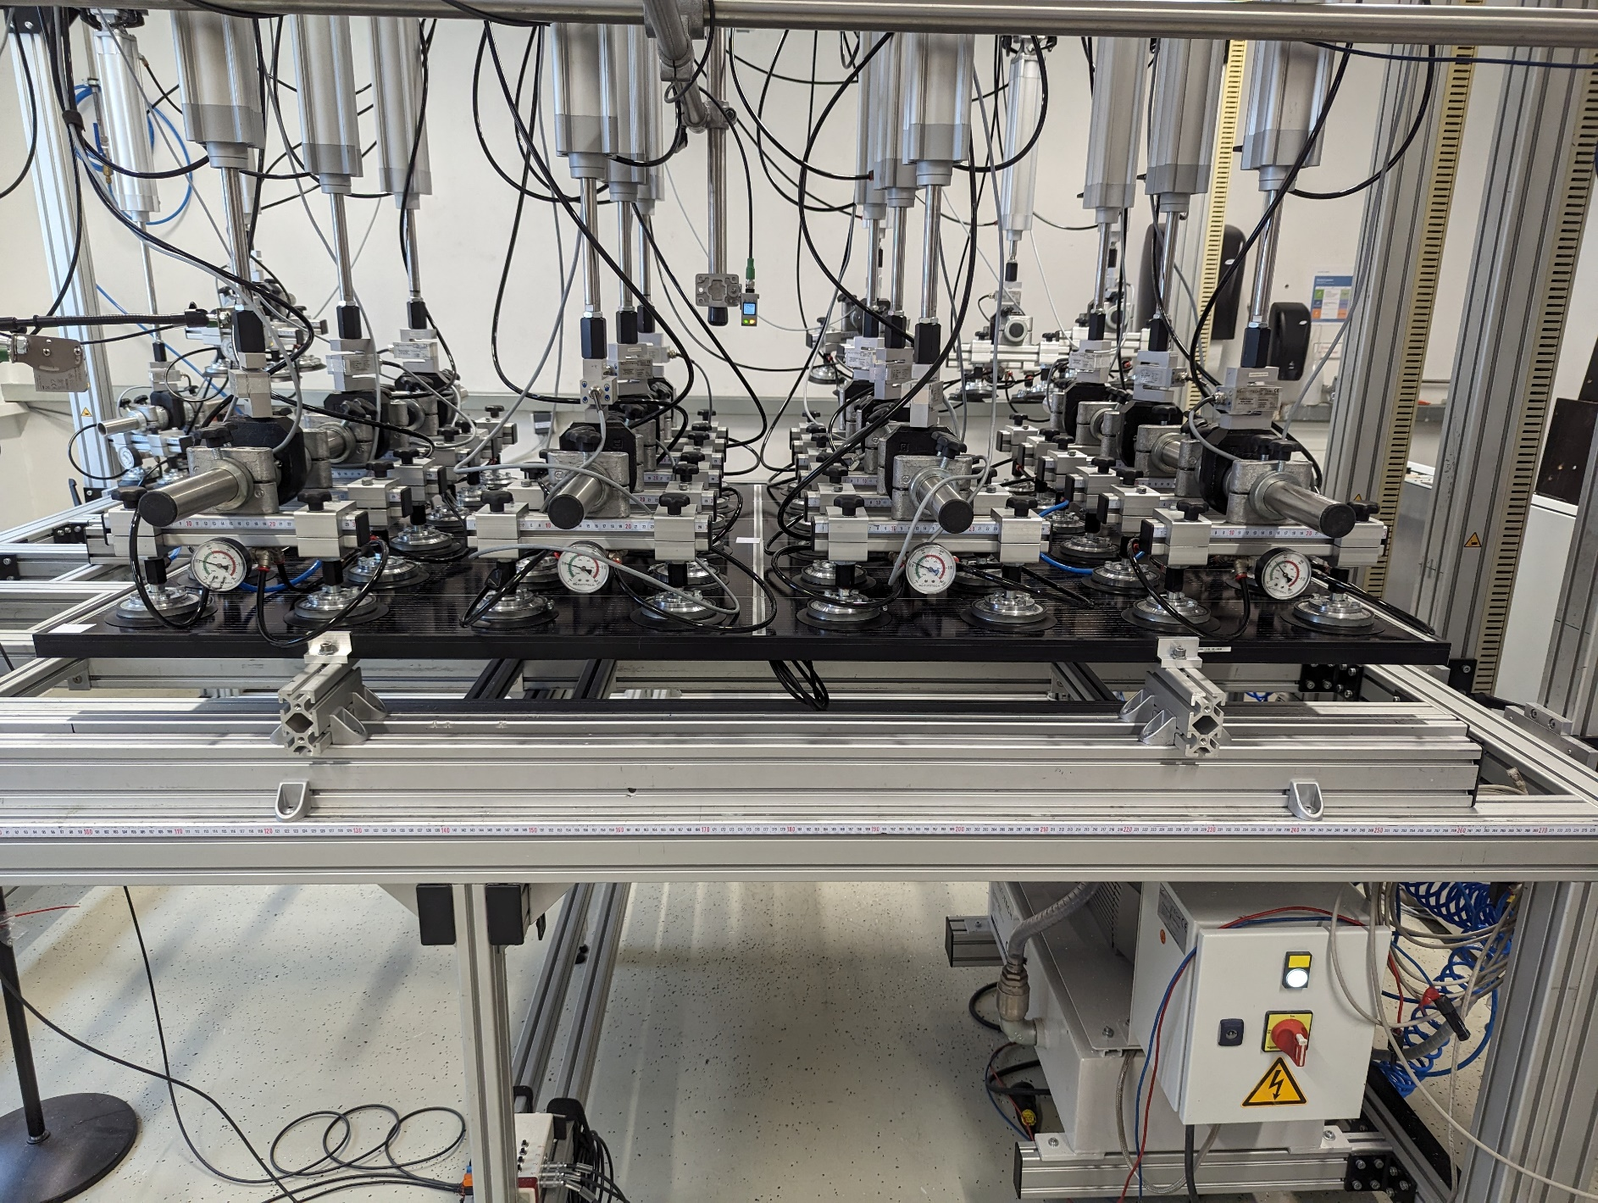
Results
PV Modules – Mechanical Load Tests Until Failure
ML Tests until failure in pressure direction
      4-point fixation at 20 % of the long module side without cross braces
        Free deflection allowed
      Homogeneous load distribution on the surface

Slide 19
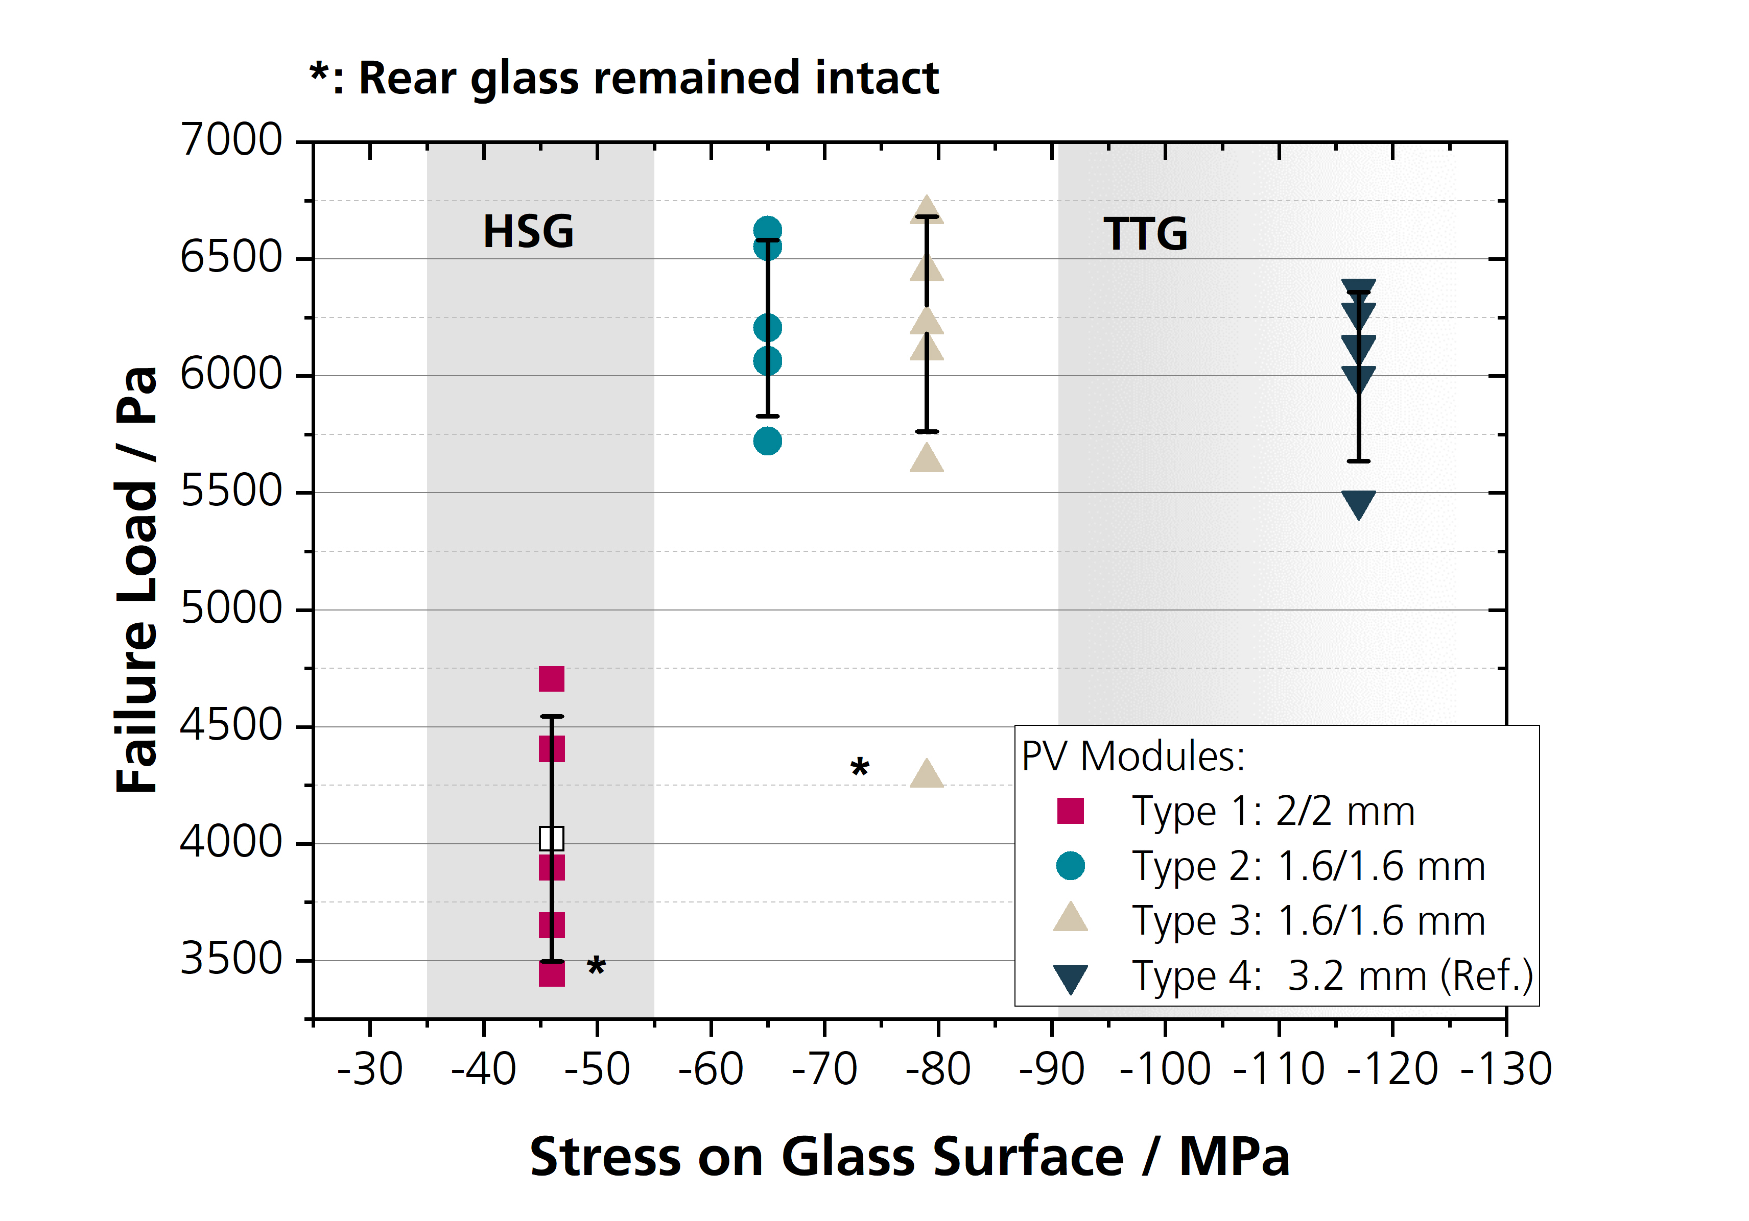
Results
PV Modules – Mechanical Load Tests Until Failure
Results:
      Module type with lowest surface stress showed significantly reduced failure loads
      Module with 1.6 mm panes showed comparable failure loads than the reference module with 3.2 mm TTG
Notes:
Dünnes Glas kann Deformation besser aufnehmen als dickes, aber es scheint kritische Wert für die Glasvorspannung zu geben die bei homogener Belastung zum Tragen kommt

Slide 20
Summary and Outlook
Preliminary Results
      SCALP can be used as an additional evaluation method for glass quality in PV modules
      Glass surface stress seems to show an influence on failure load of PV modules
      The basic expectation that 1.6 mm panes show generally lower surface stresses than thicker panes could not be verified
      With regard to homogeneous surface loads, no negative influence on the general module stability of thin glass modules could be observed in this series of tests
Notes:
Übliche Qualitätsbestimmung mit Methoden aus Glasindustrie nicht möglich
Ausblick: Studie geplant mit großen Modulen gleiches Moduildesigns und konstanten Glasdicken. Annahme: Unterschiede in der Glasvorspannung (falls vorhanden) sollten besser aufflösbar sein
Inhomogene Lasten

Slide 21
Thank you for your
Attention
  —

Slide 22
Contact
  —
    Jochen Markert (M. Sc.)
    Department Module Characterization and Reliability
    Tel. +49 761 4588-5879
    jochen.markert@ise.fraunhofer.de
      Fraunhofer ISE
      Heidenhofstraße 2
      79110 Freiburg
      www.ise.fraunhofer.de

Slide 23
References
    [1] Wagner, E. Glasschäden: Oberflächenbeschädigungen, Glasbrüche in Theorie und Praxis, 5., überarbeitete und erweiterte Auflage; Fraunhofer IRB Verlag: Stuttgart, 2020, ISBN 978-3-7388-0532-1.
    .

Slide 24
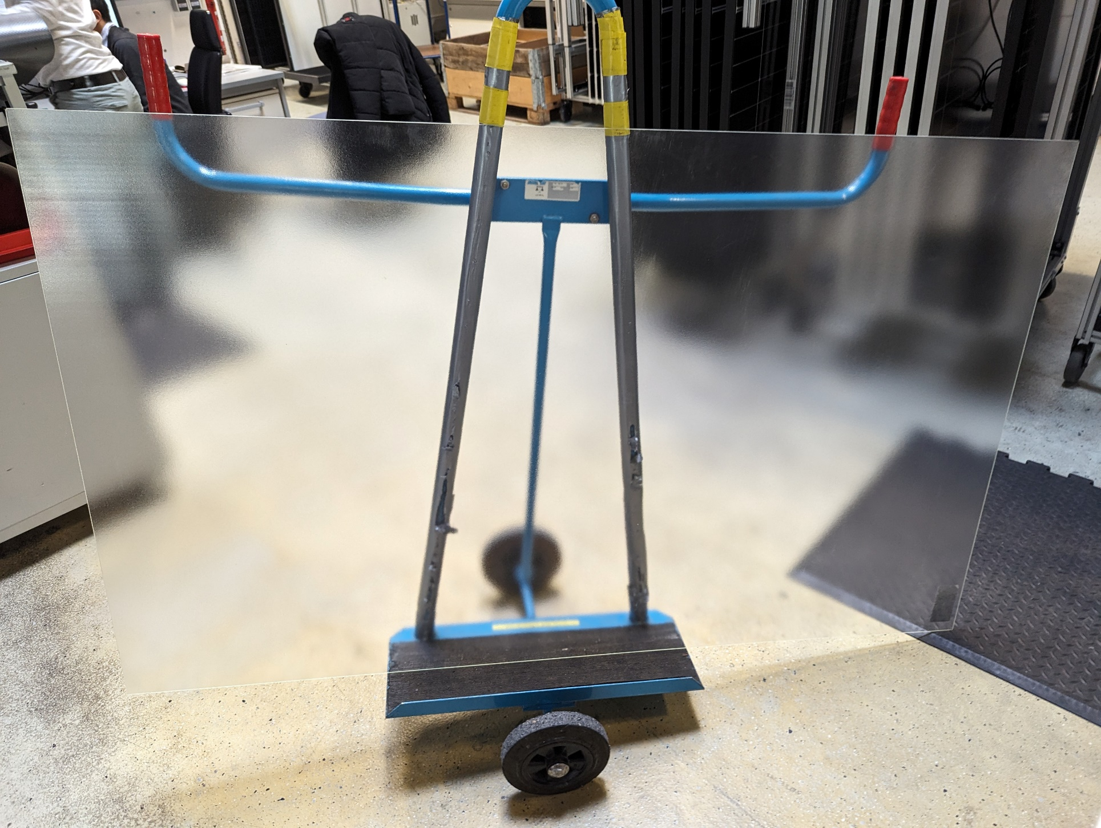
Results
PV Glass – Influence of ARC
Pane with ARC on only one side
      15 measurement points on front and rear side

Slide 25
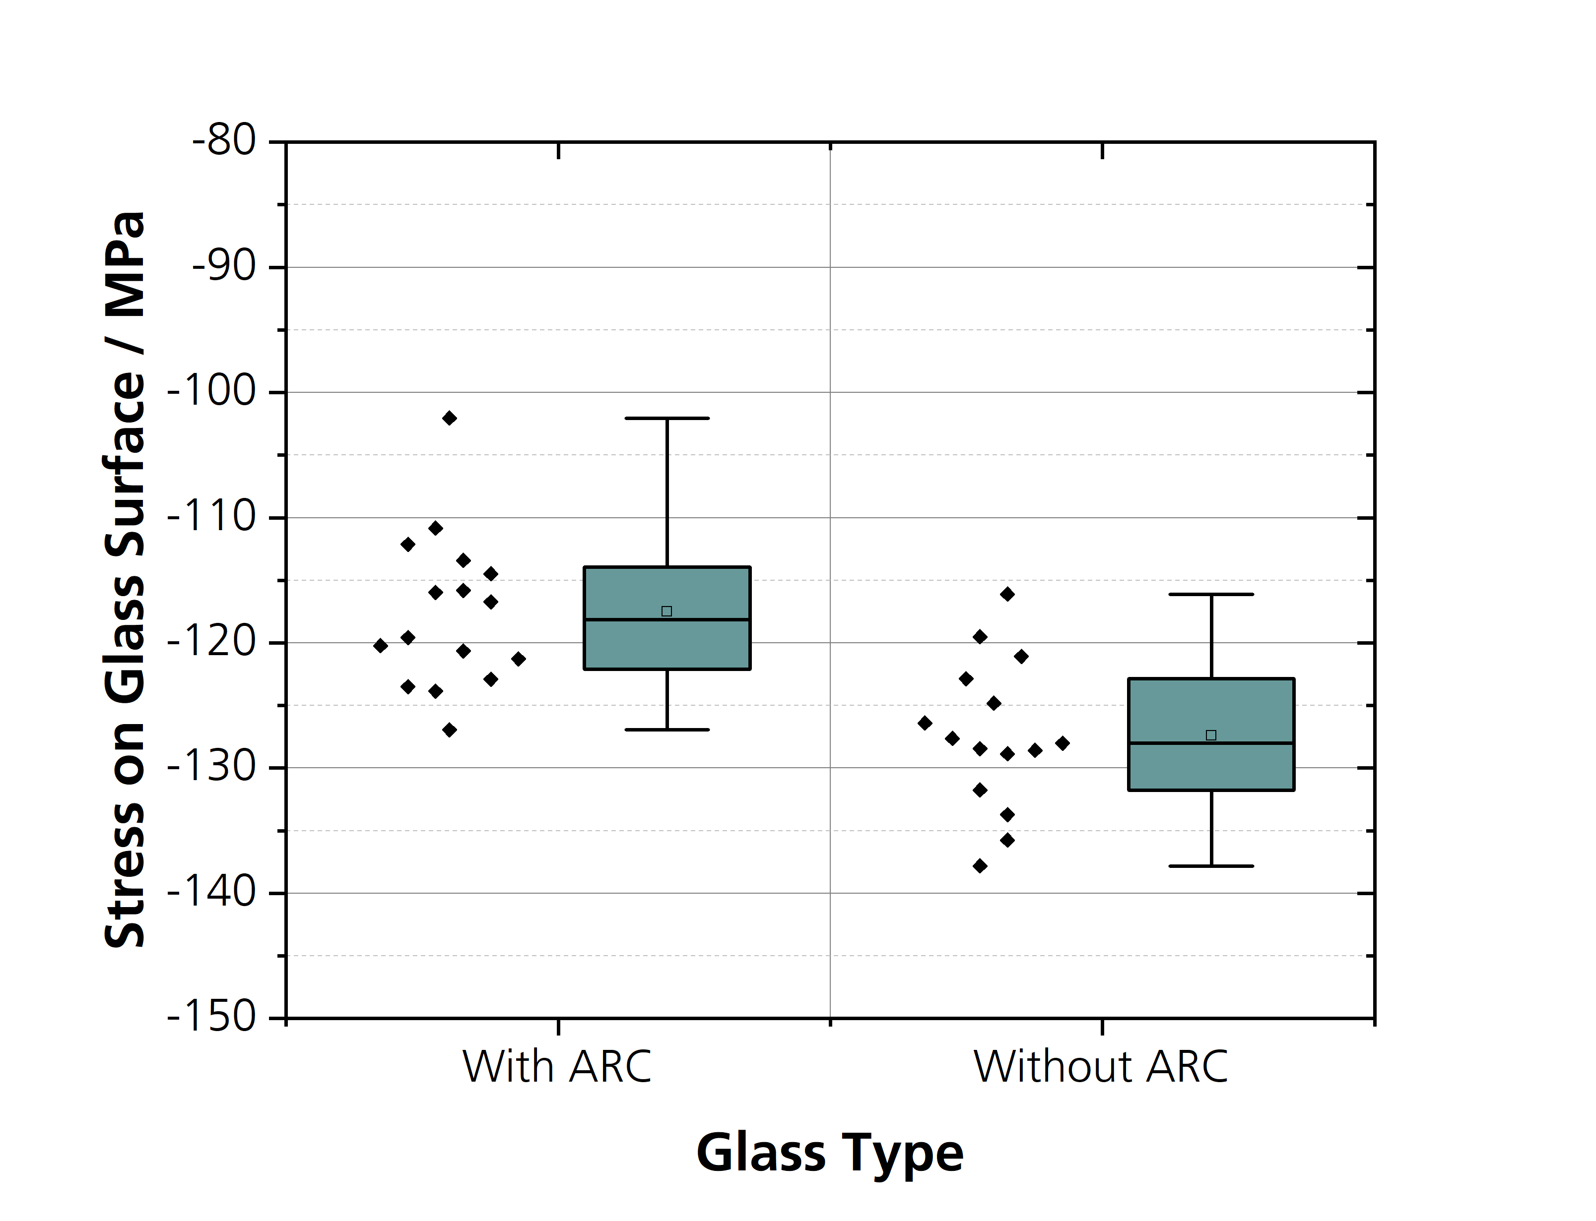
Results
PV Glass – Influence of ARC
Pane with ARC on only one side
      15 measurement points on front and rear side
      Influence of ARC:
        Higher measurement inaccuracy
        Compressive stress slightly under-estimated with ARC coating
        Δ ≈ 10 MPa

