Slide 1
Lightweight Modules Ignitability Test: In-house instrument development and material characterisation assessment
Florian Ollagnon, Umang Desai, Emma Gottis, Jérémie Bonvin, Hengyu Li, Kléber Nicolet, Matthieu Despeisse, Aïcha Hessler-Wyser, Antonin Faes, Christophe Ballif
26th of April 2024

Slide 2
Index
Lightweight PV – importance of fire tests
Existing standards
In-house instrument development
Source of material flammability
Polymeric Honeycomb
Fire retardant encapsulants analysis
Conclusion
Future Works

Slide 3
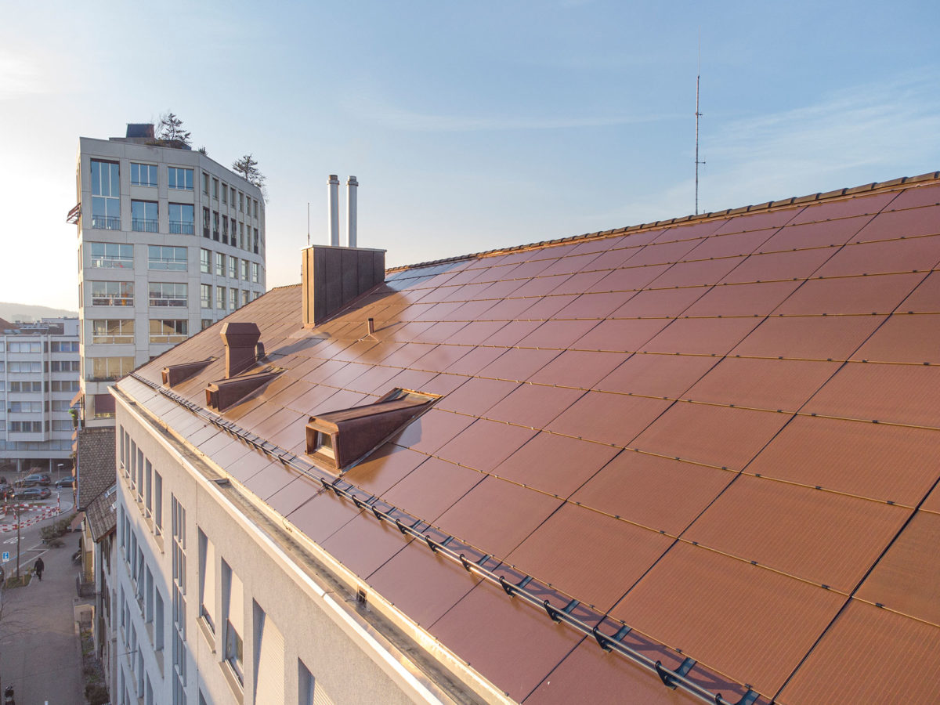
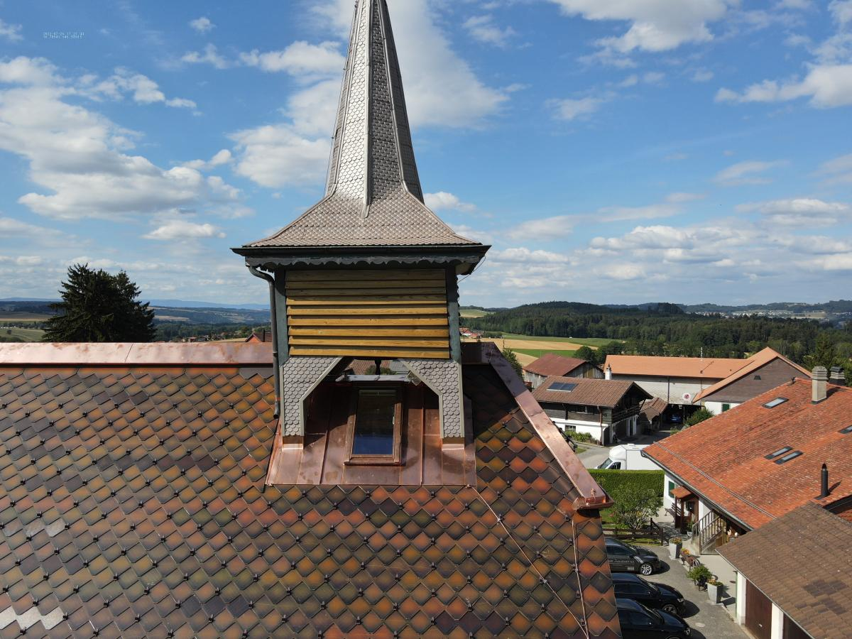
Lightweight PV
Building integrated PV (BIPV): increase acceptance of PV in buildings
Roof in Zurich made by 3S [1]
FreeSuns tiles on a heritage building [2]
Conventional PV modules heavy: 12 to 20 kg/m² [3]
Mounting structure: ~20 kg/m² [4]
Not suitable for applications such as old infrastructures or barns.
1. Bellini, “Invisible BIPV system covers building in Zurich’s city center,” pv. https://www.pv-magazine.com/2021/09/29/invisible-bipv-system-covers-building-in-zurichs-city-center/
2. Freesuns, “Listed building in Ferlens,” Freesuns | Solar Roofs. https://freesuns.com/./en/project?ferlens-listed-building-in-ferlens
3. A. C. Martins, Eds., “Ultra-lightweight PV module design for building-integrated photovoltaics,” Proc. 44th IEEE Photovolt. Spec. Conf. IEEE, 2017, doi: 10.1109/PVSC.2017.8366791
4. Aliva glass cladding system, https://www.aliva.it/systems/ali-glass-s_7/#prettyPhoto, visited on 01.03.2024

Slide 4
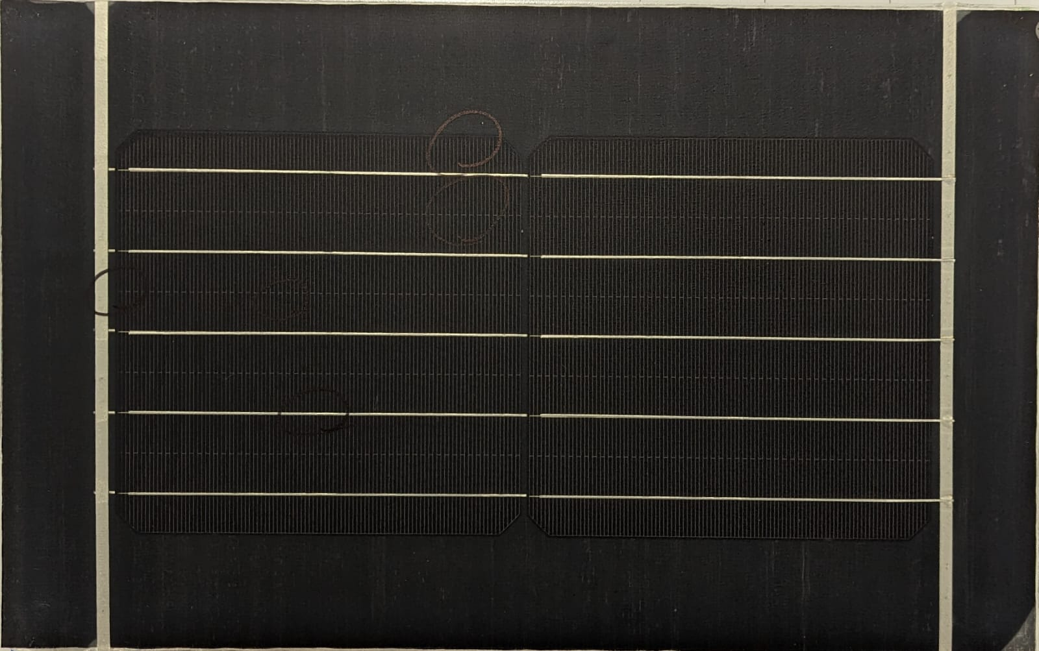
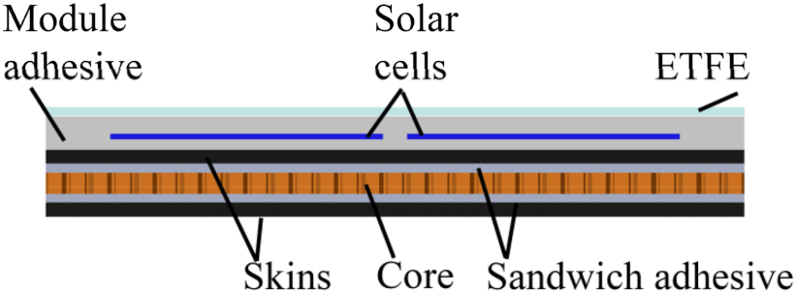
Lightweight PV
Structure of the LW PV module [5]
Module less than 6 kg/m²
Mounting structure of about 5 kg/m²
Cover glass replaced with a polymeric frontsheet
Honeycomb structure to give rigidity
Resistance towards external stressors?
5. A. C. Martins, V. Chapuis, A. Virtuani and C. Ballif, "Robust Glass-Free Lightweight Photovoltaic Modules With Improved Resistance to Mechanical Loads and Impact," in IEEE Journal of Photovoltaics, vol. 9, no. 1, pp. 245-251, Jan. 2019

Slide 5
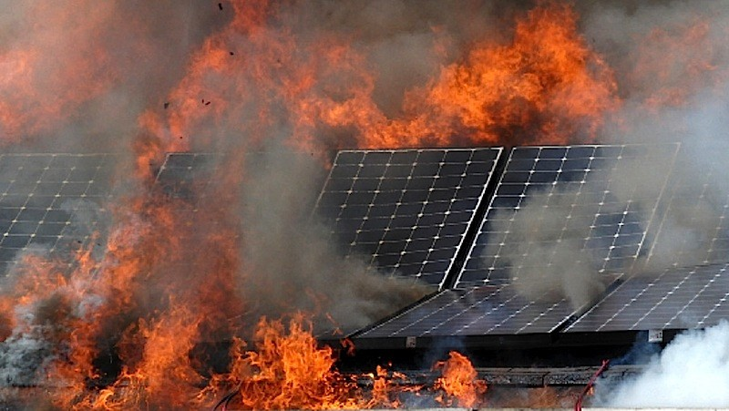
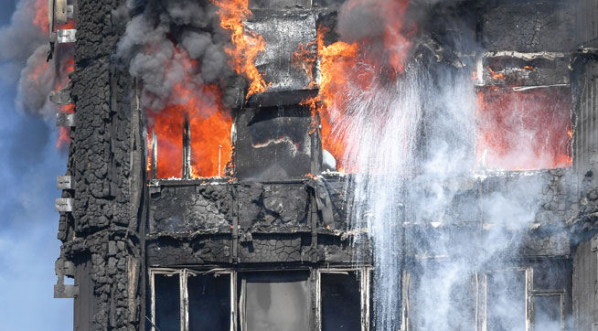
Lightweight PV
BIPV: Module become a building component → need to comply with local building norms for acceptance
Fire resistance critical for lightweight (LW) PV to access the market.
Solar roof fire [6]
Grenfell tower fire, 2017 [7]
6. https://solarfiresystems.com/news/solar-panel-safety-safely-de-energise-photovoltaic-panels
7. https://wfmmedia.com/facade-fire-safety-need-for-performance-testing-certification/

Slide 6
Fire standards – Switzerland case study
Fire classification for building materials and regulations developed by the AEAI (Association des établissements cantonaux d’assurance incendie) [8]:
Swiss classification | Reaction to fire
RF1 | No contribution to fire
RF2 | Weak contribution to fire
RF3 | Admissible contribution to fire
RF4 | Inadmissible contribution to fire
RF3
RF2
RF1
>30m
11-30m
<11m
Small
Medium
High
BIPV modules need to pass RF2 to be implemented into medium-size building !
8. AEAI, 2018. 1001-15 Bâtiments d’habitation.

Slide 7
Fire standards – Switzerland case study
Based on the European norms EN13501 “Fire classification of construction products and building elements” [9]
Swiss class | EN Class | Test method | Examples [10]
RF1 | A1 | EN ISO 1182 EN ISO 1716 | Stone, steel
 | A2 | EN ISO 1182 EN ISO 1716 EN 13823 | Bricks with 1% organic compounds
RF2
 | B | EN 13823 EN ISO 11925-2 | Wood with fire protection
 | C | EN 13823 EN ISO 11925-2 | Gypsum board, Conventional PV
RF3 | D | EN 13823 EN ISO 11925-2 | Wood
 | E | EN ISO 11925-2 | Thermoplastics without fire retardants
RF4 | F | EN ISO 11925-2
9. EN-13501, 2018
10. [1] AEAI, “Répertoire de la protection incendie AEAI.” https://www.bsronline.ch/fr

Slide 8
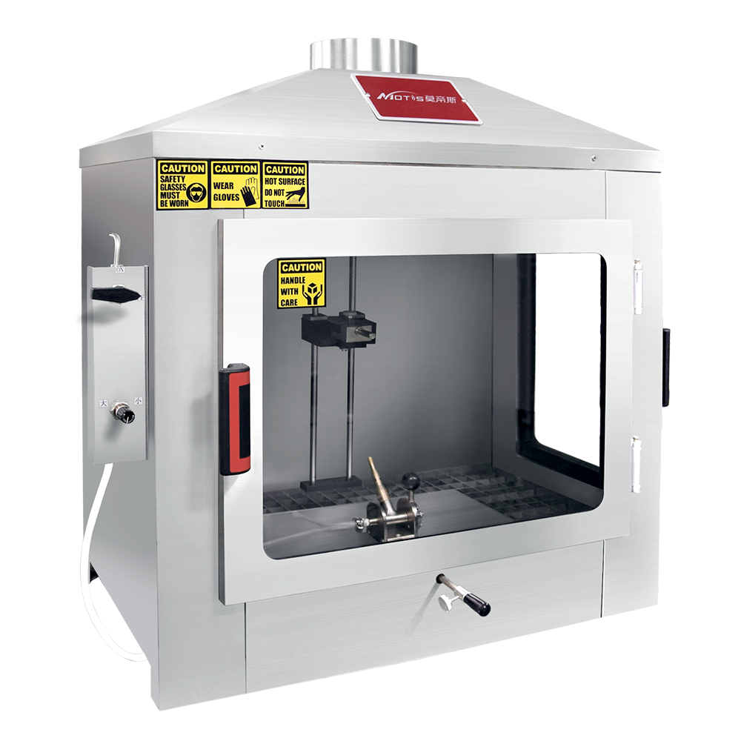
Fire standards – Switzerland case study
EN ISO 11925-2 “Reaction to fire tests — Ignitability of products subjected to direct impingement of flame” [11]
Study how a flame spread vertically on a material’s surface over a period of time.
250 mm
90 mm
Edge
Surface
[12]
Type of test | Single flame exposure time | Waiting time after exposure | Metrics
Edge or Surface | 15 s | 5s | F_{s} < 150 mm
 | 30 s | 30s
Fs : flame height from the flame exposition point
11.EN ISO 11925-2
12.“ISO 11925-2 Single-Flame Source Test | Ignitability Apparatus,” Motis Fire Testing Instrumentation. https://www.motistech.com/instrumentation/single-flame-source-test-ignitability-apparatus

Slide 9
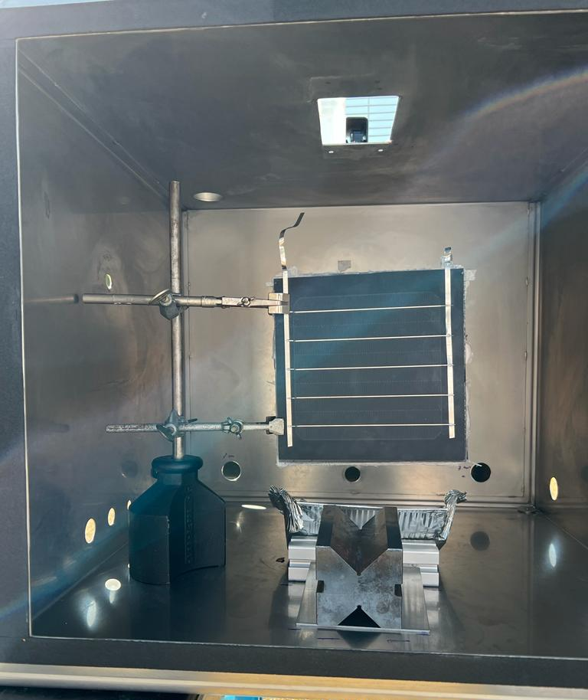
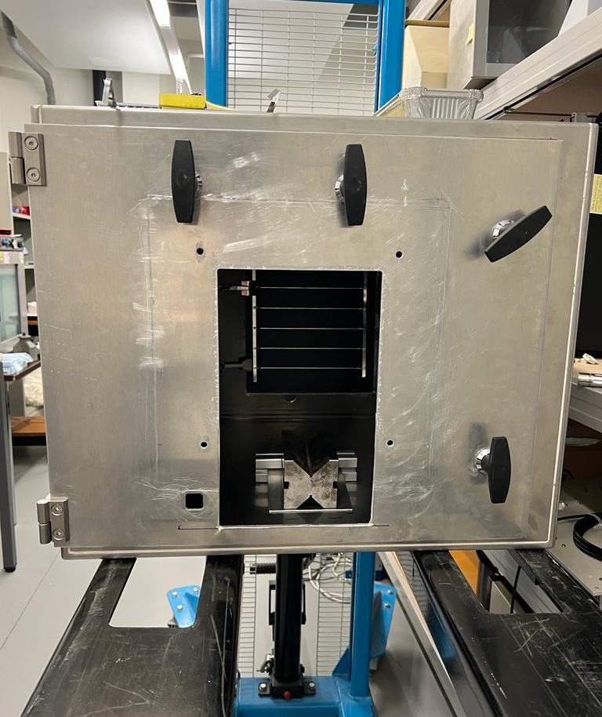
In-house instrument development
Flame angle of 45°
Timer
Observation of ignition
2 cm flame
Flame from a standard apparatus
Gas pressure 0.1-0.5bar
Propane 95% purity
Property | Propane | Butane
Heat of combustion [kJ/kg] [13] | -50.33 | -49.70
Flame temperature in air [°C] [14] | 1980 | 1970
Flame from in-house apparatus
Made for preliminary test only! Do not replace standardization facilities or apparatus.
13. National Institute of Standards and Technology, “NIST Standard Reference Database.”, 2023. https://doi.org/10.18434/T4D303
14. Helmenstine, Anne Marie, Ph.D. "Flame Temperatures Table for Different Fuels." ThoughtCo, Aug. 27, 2020, thoughtco.com/flame-temperatures-table-607307.

Slide 10
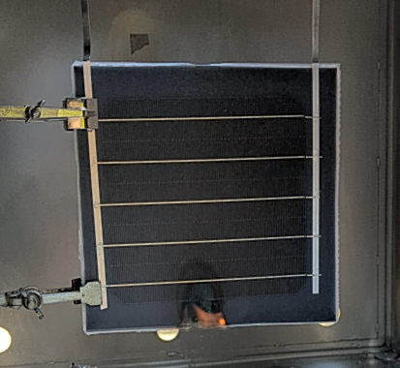
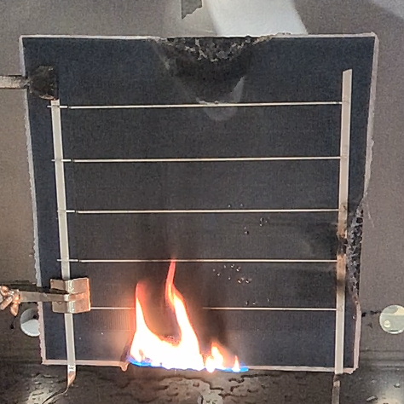
Lightweight module fire test
ETFE
PERC
Encaps.
Encaps.
Skin
Honeycomb
15 s edge flame exposure
20 s total duration
15 cm
Picture after 20 s
30 s edge flame exposure
60 s total duration
15 cm
Sustained flame
Picture after 60 s

Slide 11
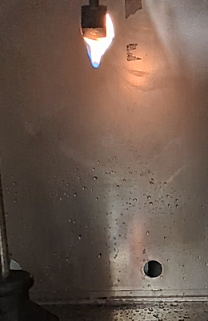
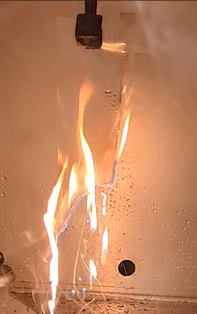
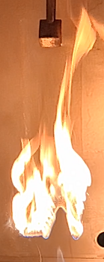
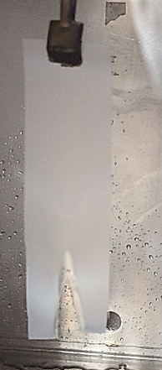
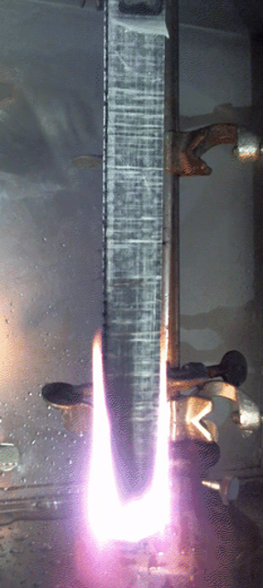
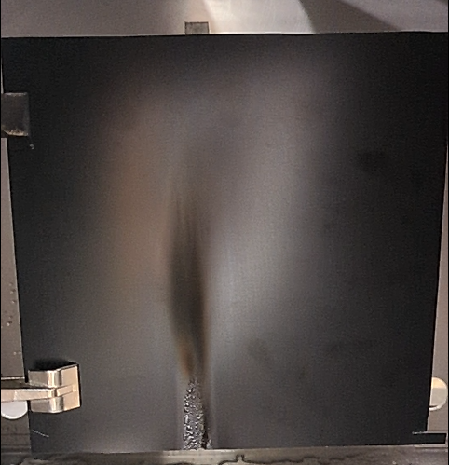
Flame source assessment
ETFE high resistance towards fire
Encapsulant is a fuel for the flame
Polymeric honeycomb (HC) contribute to the fire
E1
E2
E3
ETFE
Polymeric HC
FR skin

Slide 12
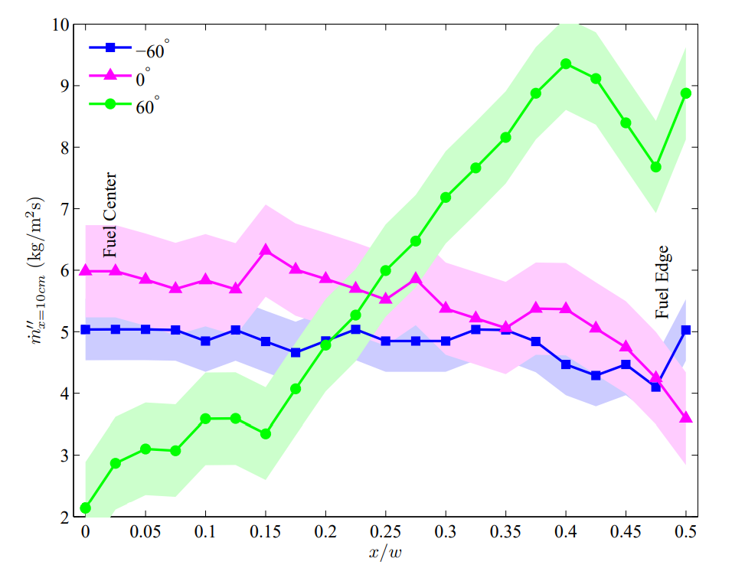
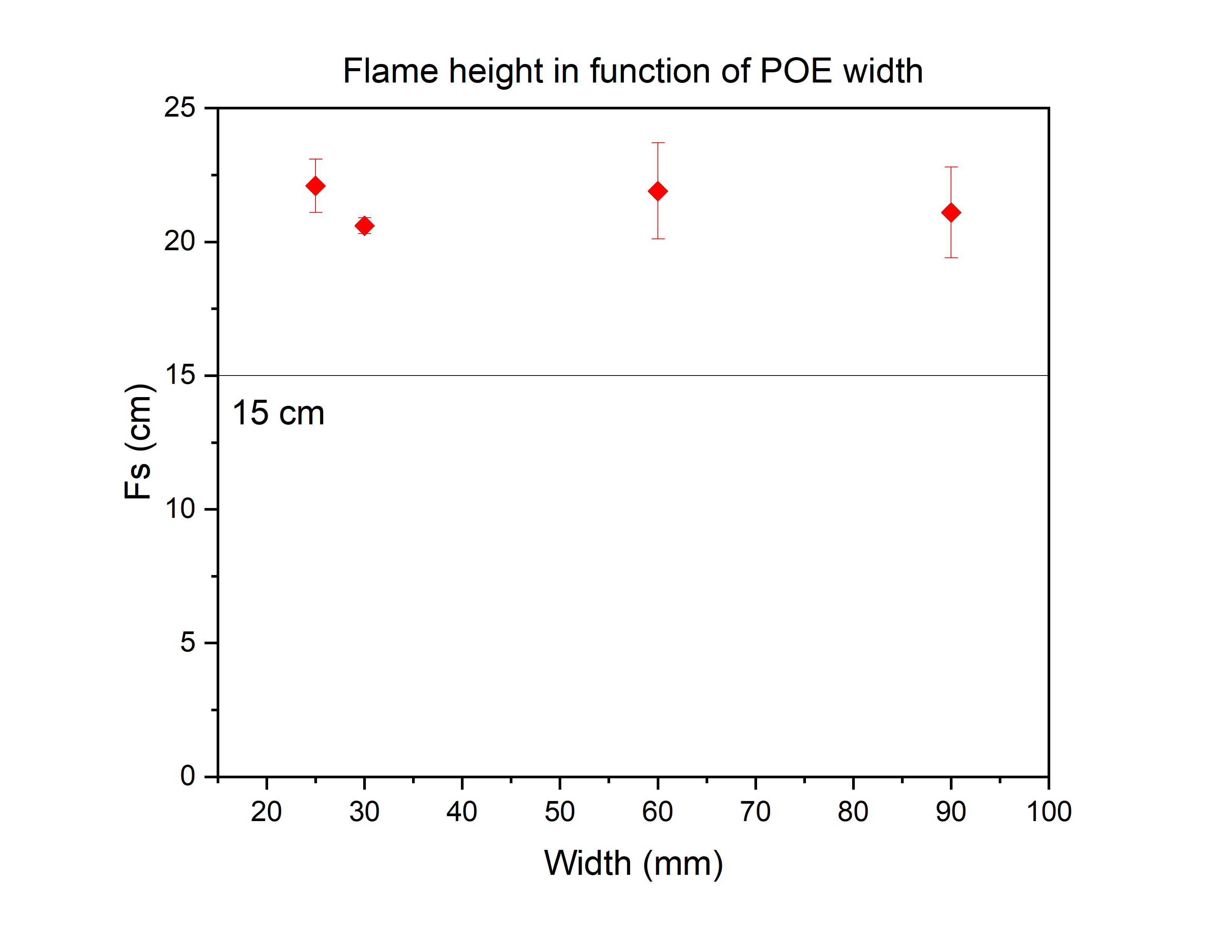
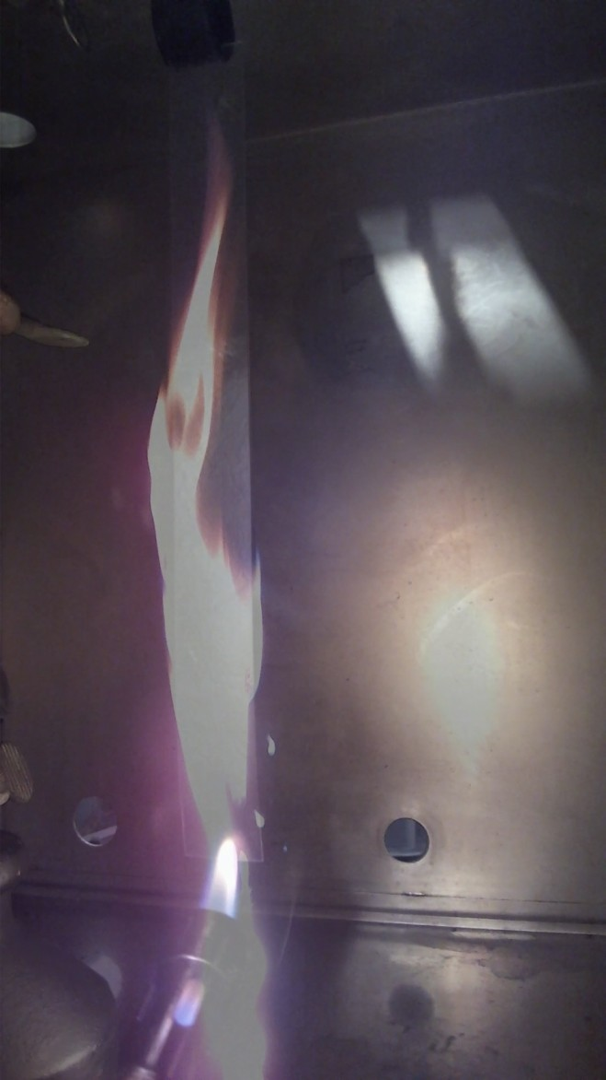
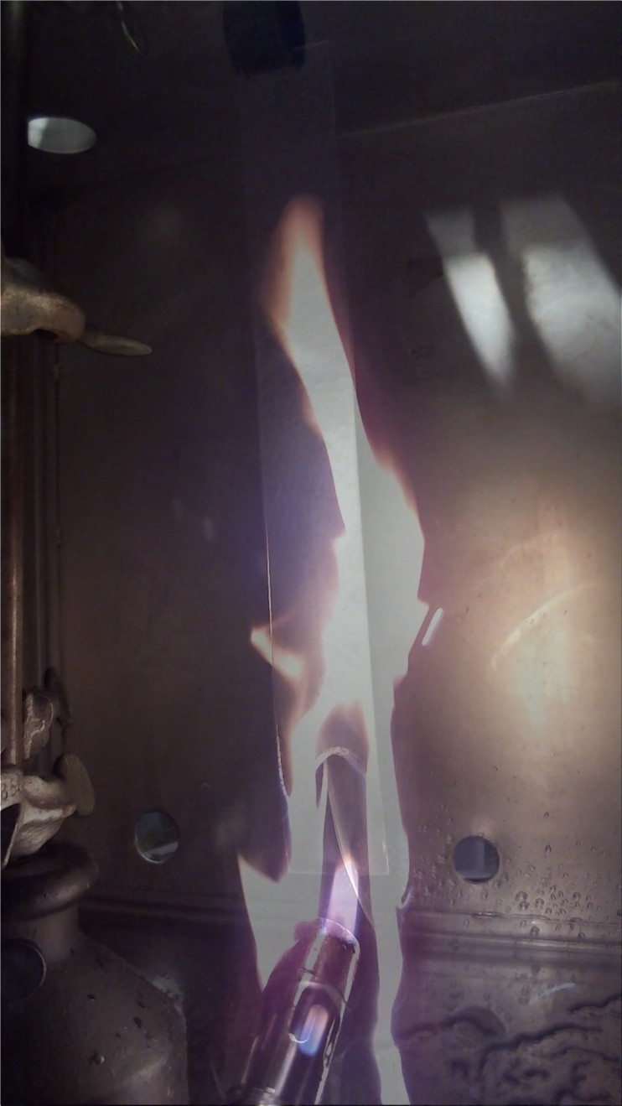
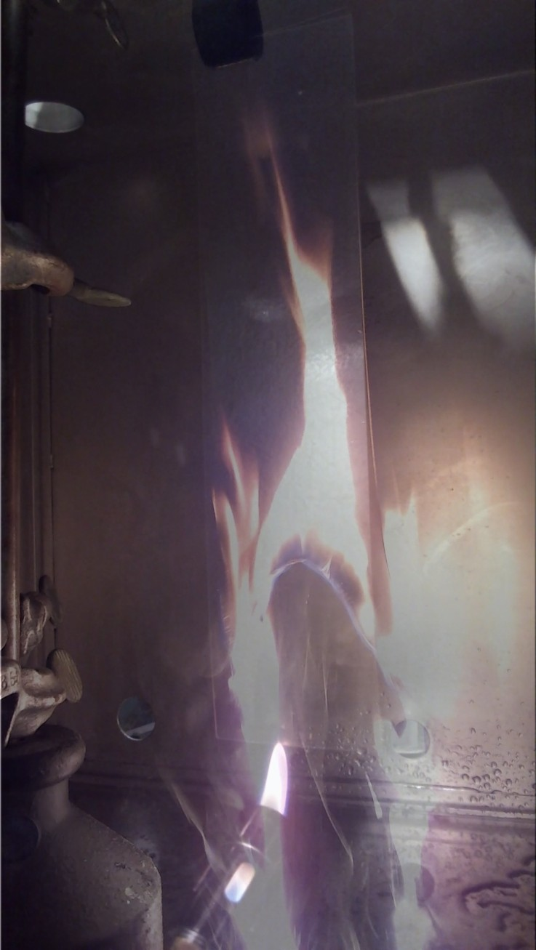
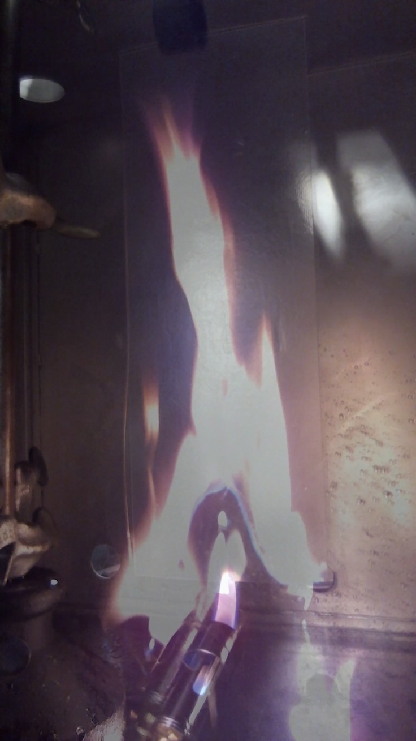
Effect of material width on flame height
Test the effect of different width on the flame height after ignition test
POE encapsulant ignited three times per width:
25 mm, 30 mm, 60 mm, 90 mm
15 s flame exposure test
Mass-loss rate from center to edge [15]
25 mm
30 mm
60 mm
90 mm
No significant impact of width on flame height
Pyrolysis region concave for wider materials
Edge effect due to increased air entrainment [15]
M. J. Gollner, “Studies on Upward Flame Spread”, Thesis, 2012.

Slide 13
Polymeric Honeycomb
Core
Skin
Two different core used: polypropylene (PP) and polyethylene terephthalate (PET):
PPGF8: PP core with PP skin reinforced with glass fiber (GF)
PPGF6: PP core and PP skin reinforced with GF with lower density
PETGF: PET core with GF reinforced PET skin
BOPET: pure PET core and skin without GF
DELIGHT project
PPGF8
PPGF6
PETGF
BOPET

Slide 14
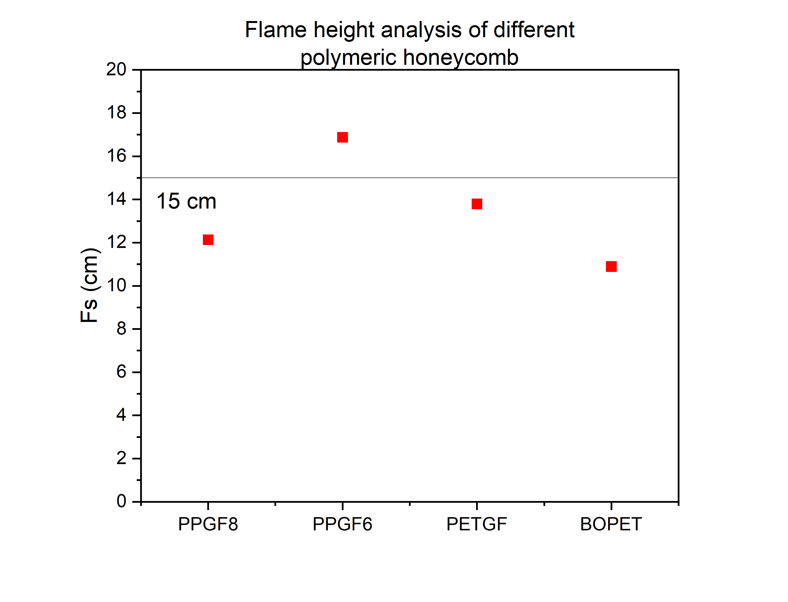
Polymeric honeycomb
15 s edge flame exposure
PPGF8
PPGF6
PETGF
BOPET
BOPET and PPGF8 seem to contribute the less to the fire, however…

Slide 15
Polymeric HC
BOPET HC structure melts away → loses its mechanical structure
PPGF8 maintain its original structure while burning → preferred choice
BOPET
PPGF8

Slide 16
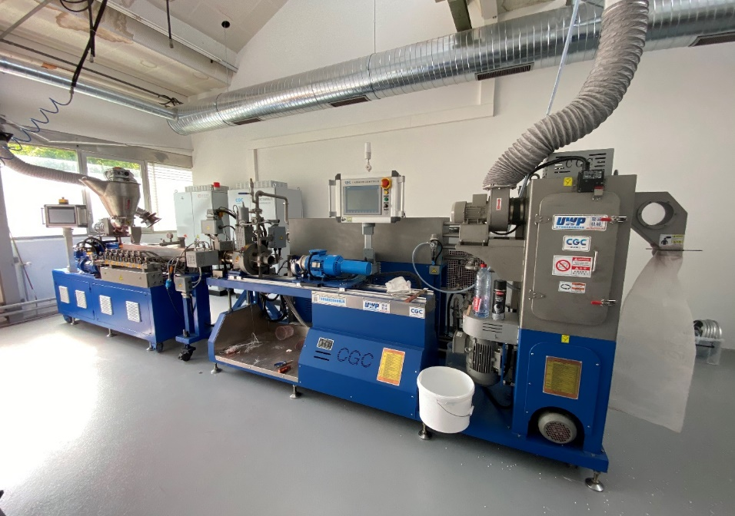
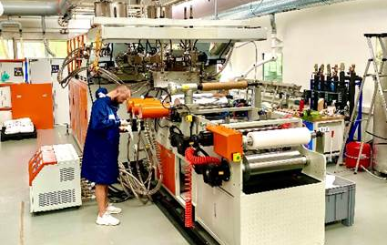
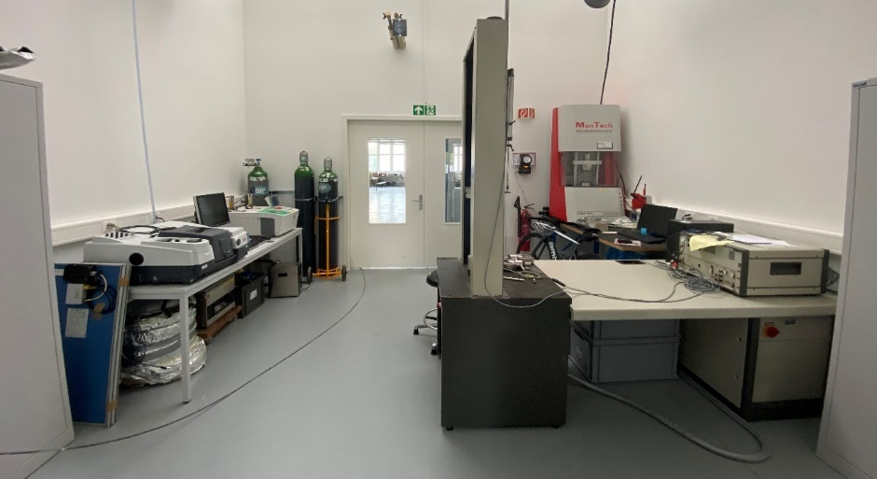
CSEM facilities for Advanced Polymers
Underwater pelletizing line, most advanced pelletizing equipment
New extrusion line enabling ABA structures, multi-materials
Characterization lab for polymers (rheology, DSC, UV-Vis spectroscopy, FTIR…)
Unique polymer platform in a PV institute for compounding and extrusion of polymers
From R&D targets to mass production for clear and coloured encapsulants
Tailored PO encapsulant for enhanced reliability
Testing of various blending at encapsulant level to improve performance and reliability of PV modules
More info: CSEM

Slide 17
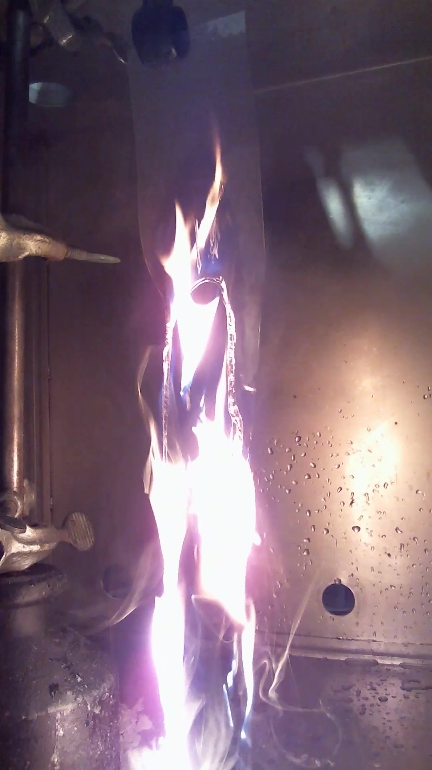
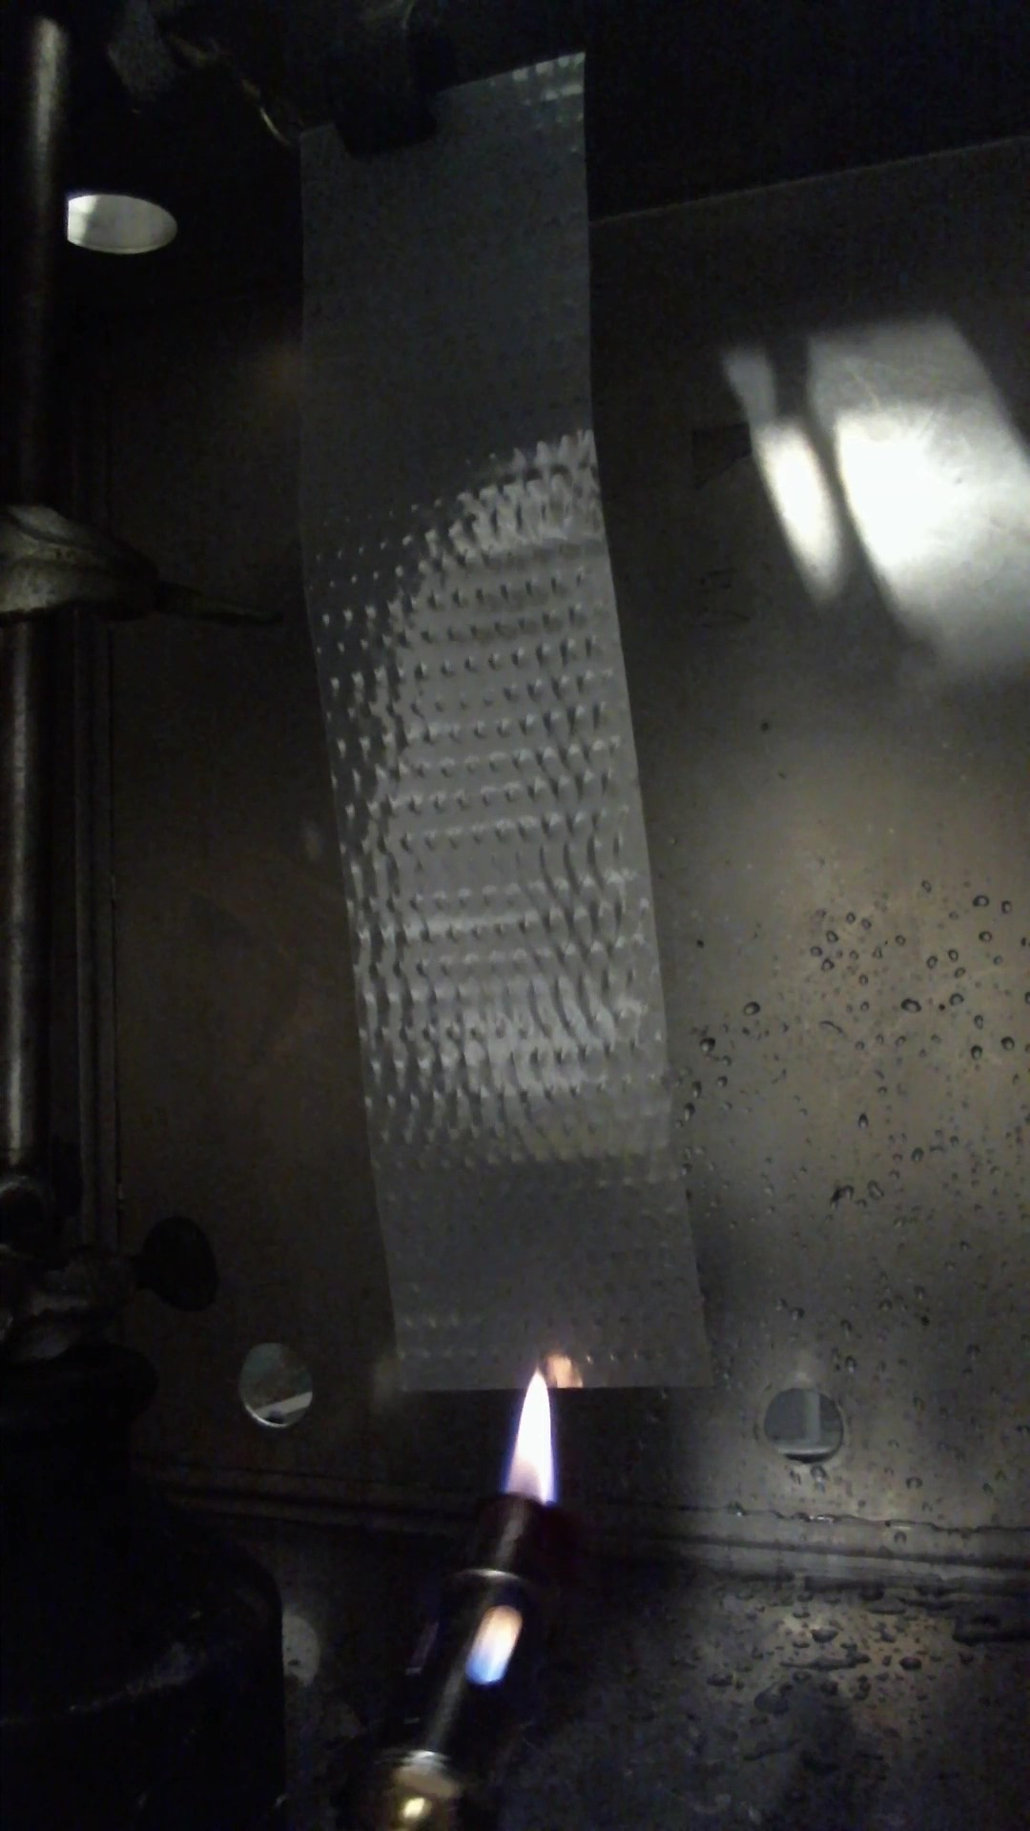
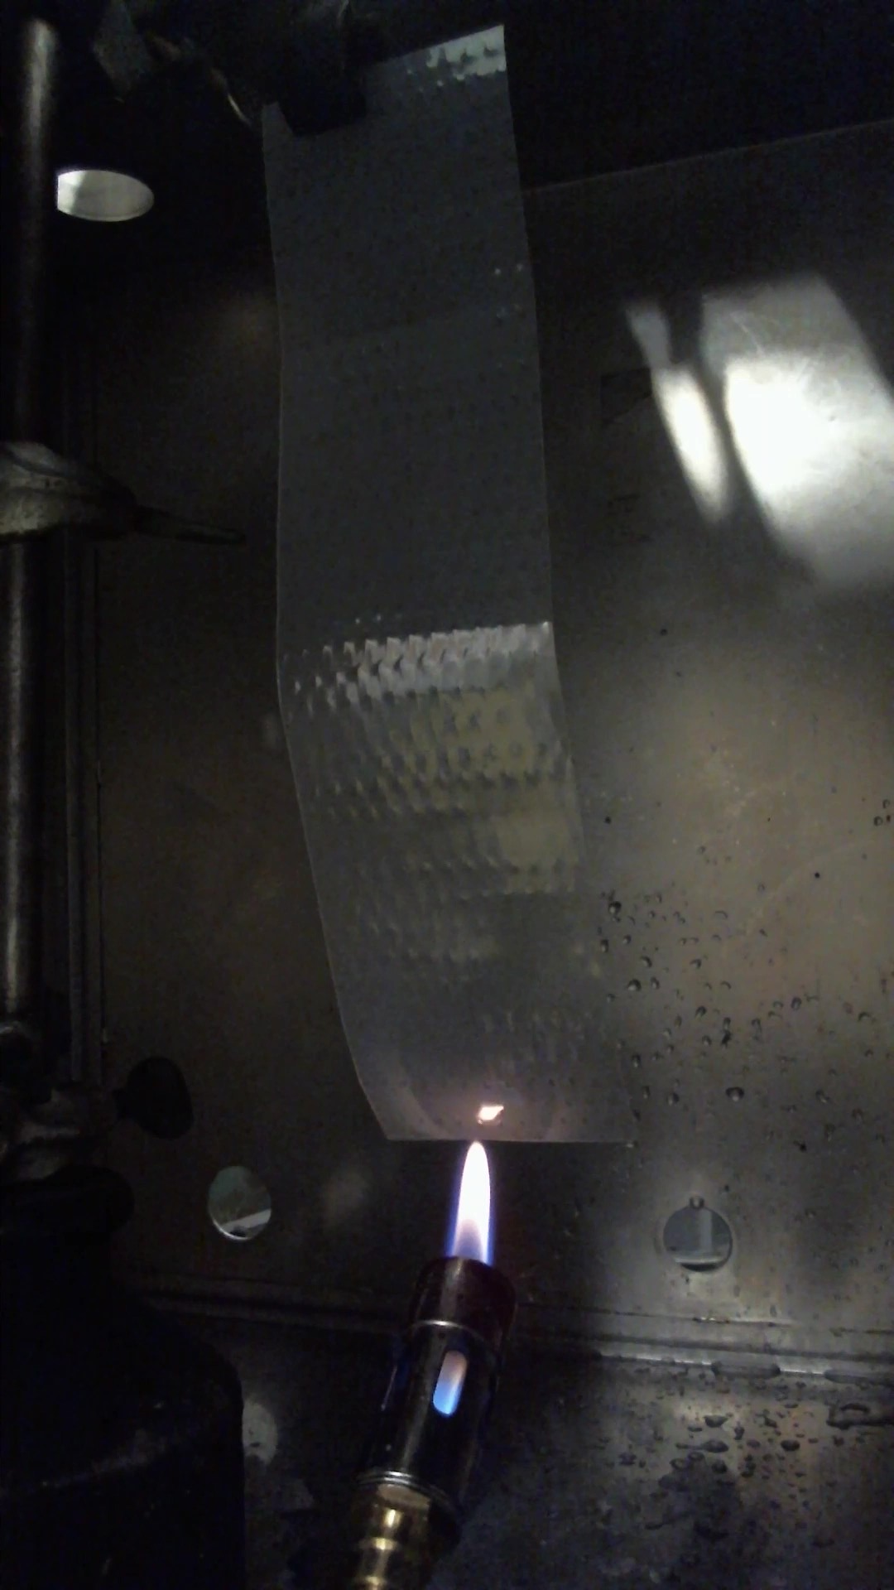
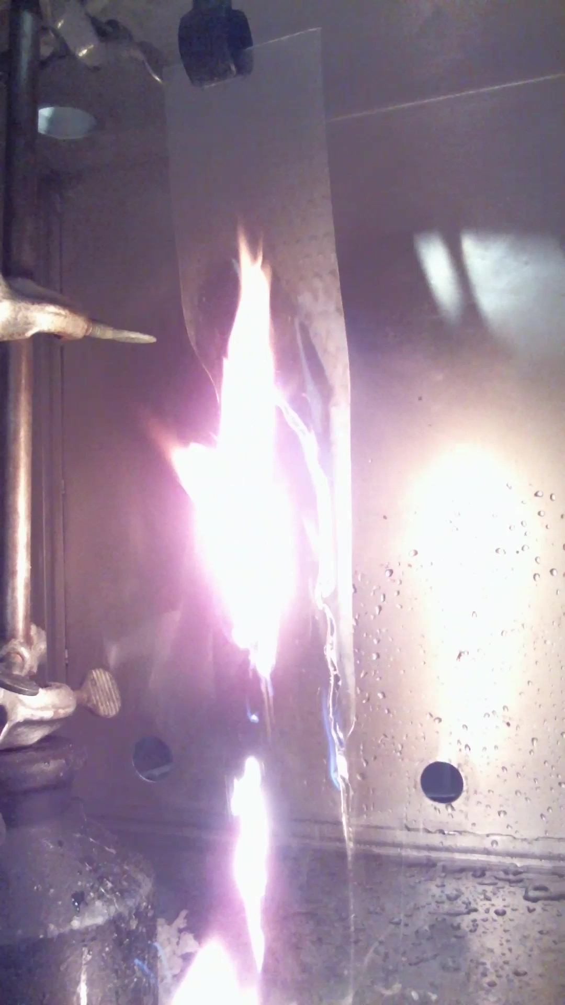
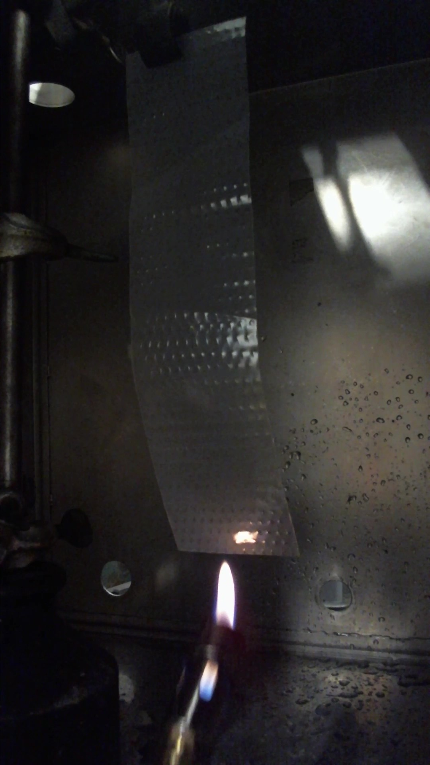
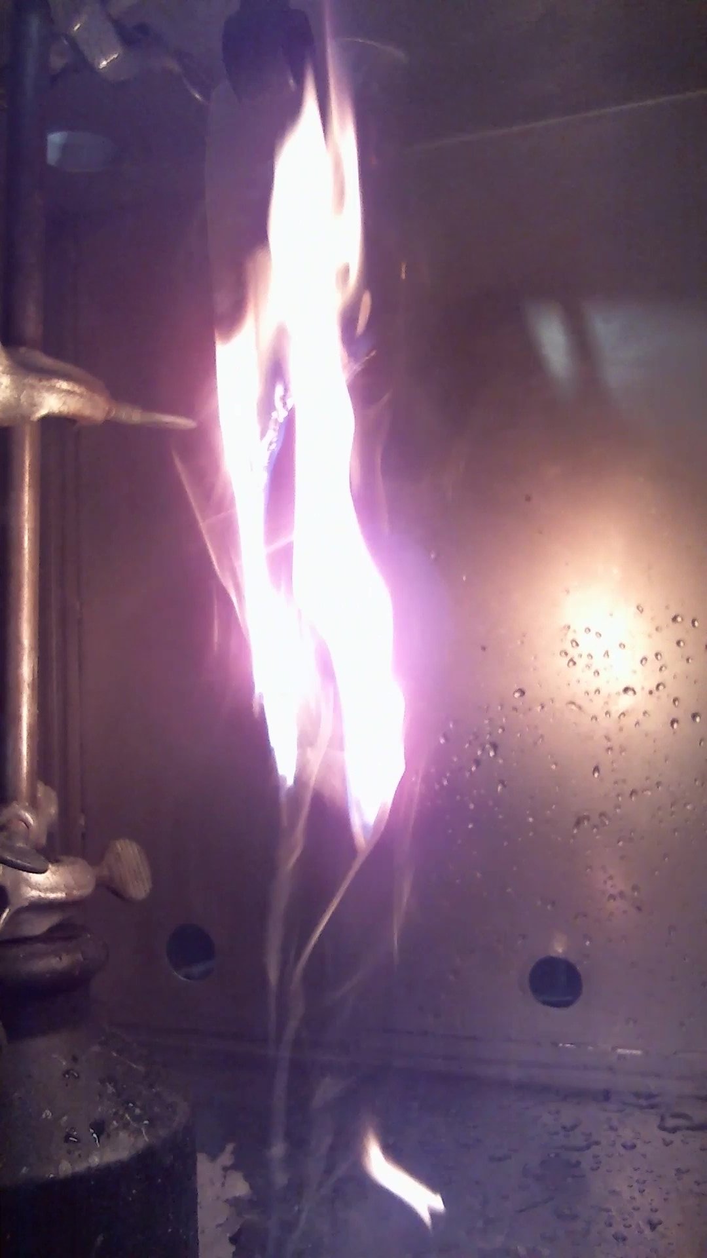
Flame retardant analysis
7 encapsulants produced by CSEM:
1 reference encapsulant
6 identical encapsulant with different flame retardants (FR)
Samples: 3x of each encapsulant with dimensions 60x250 mm
15s edge flame exposure test performed
Ref. #1
Ref. #2
Ref. #3

Slide 18
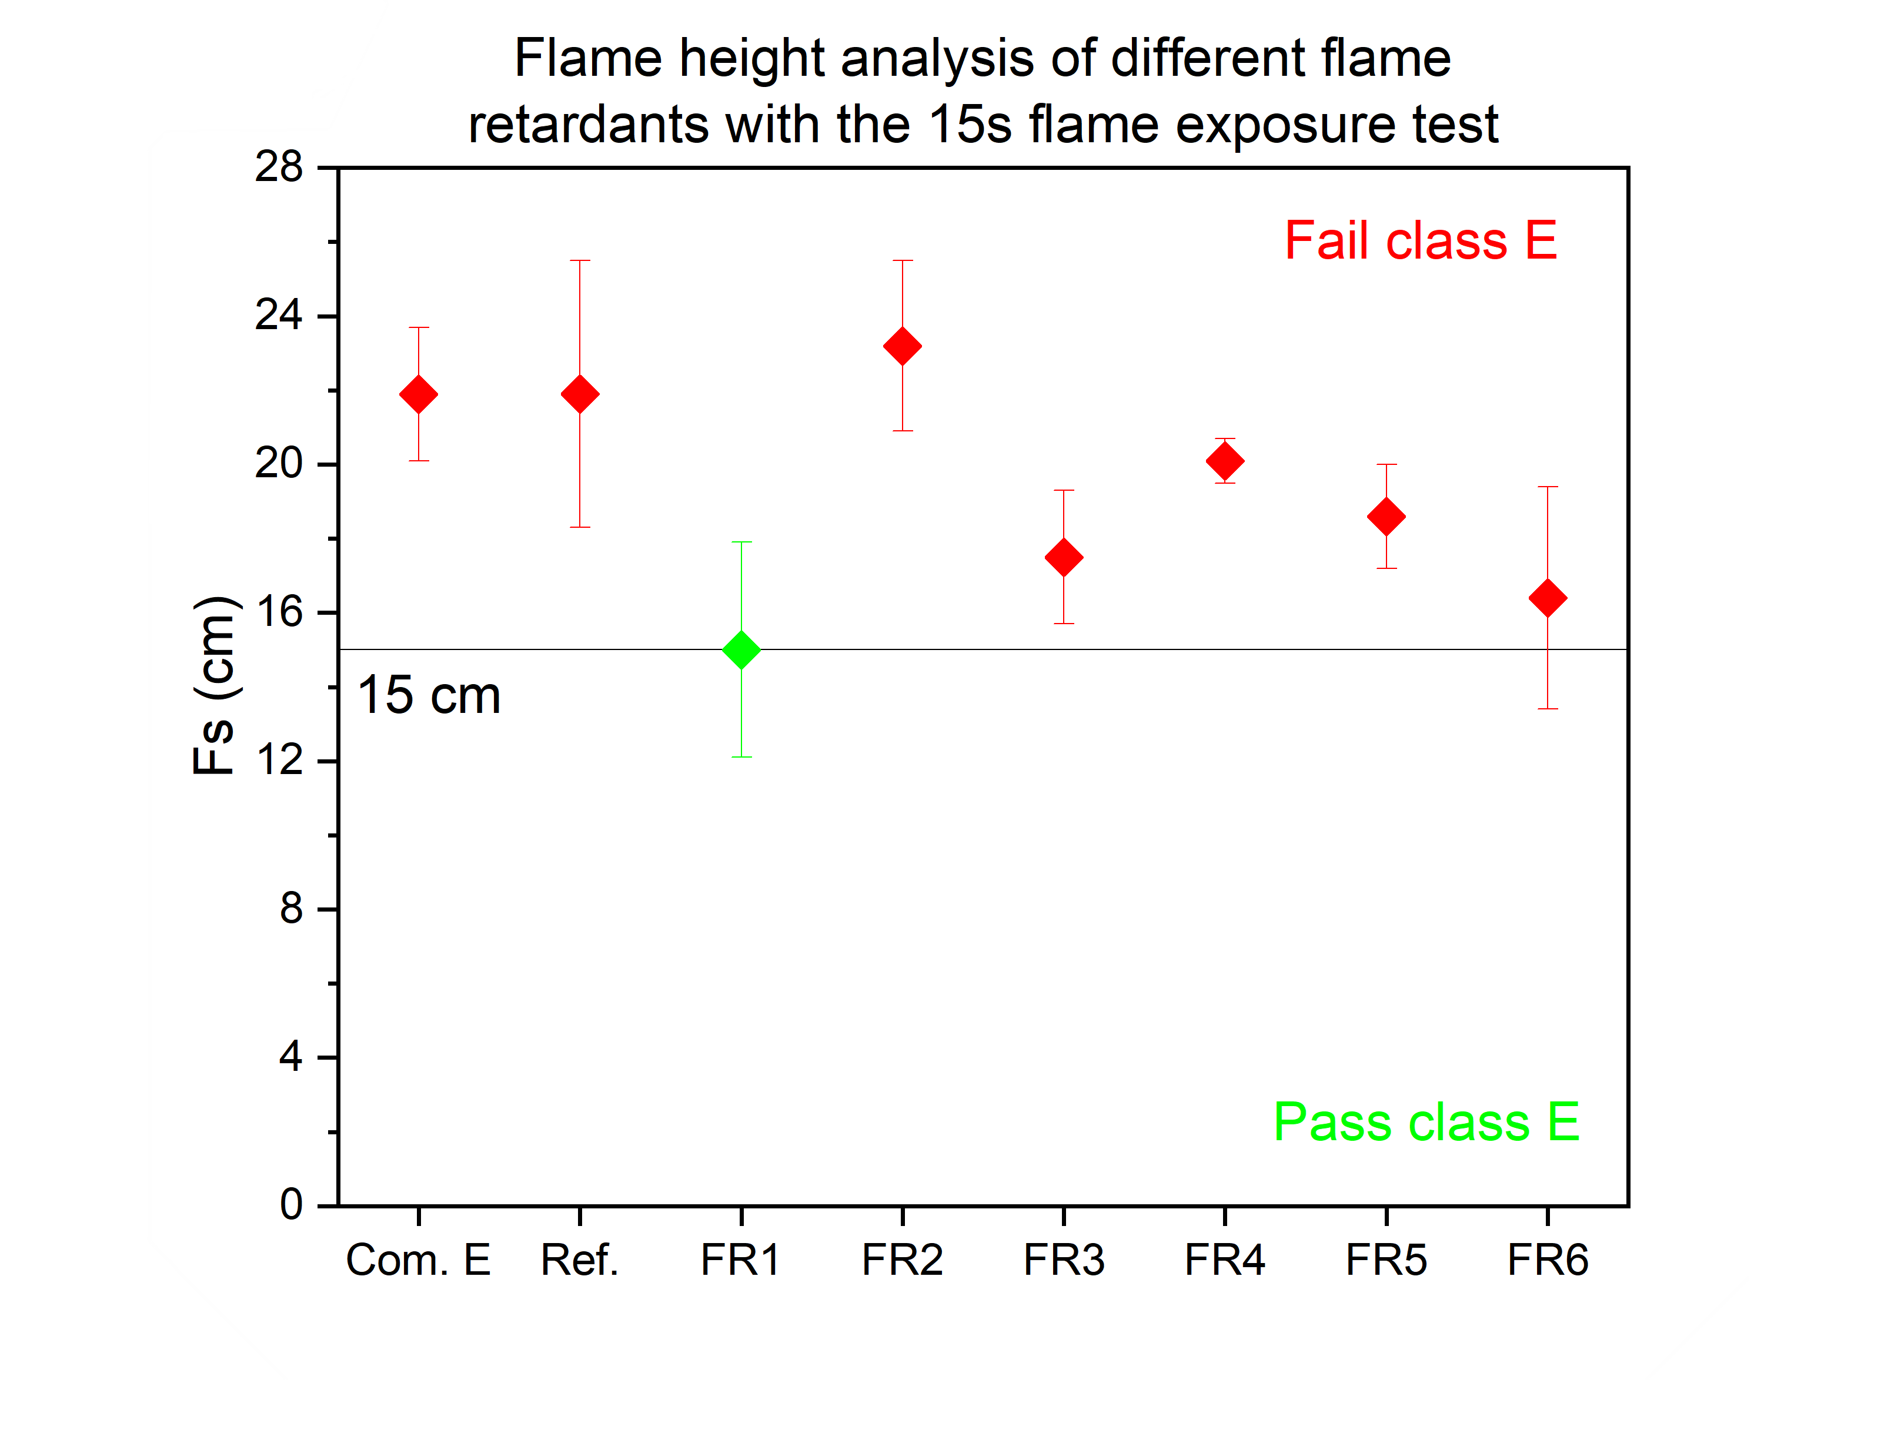
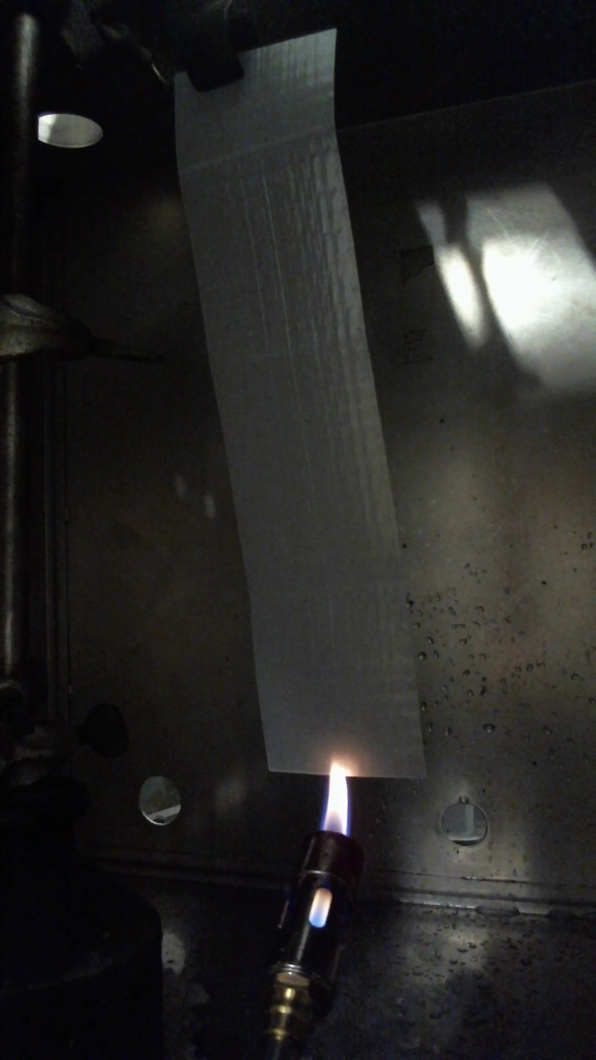
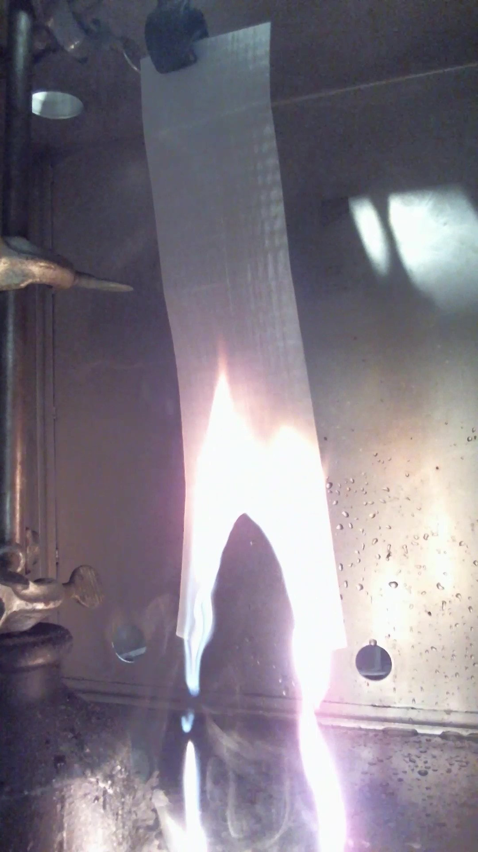
Flame retardant analysis
Ref.
FR1
FR1-containing encapsulant lowest flame height
~30% decrease in flame height compared to the reference
Flame height and flammability depends on the surface in contact with air. [16]
16. Quintiere, J. G. "A theoretical basis for flammability properties." Fire and Materials: An International Journal 30.3 (2006): 175-214.

Slide 19
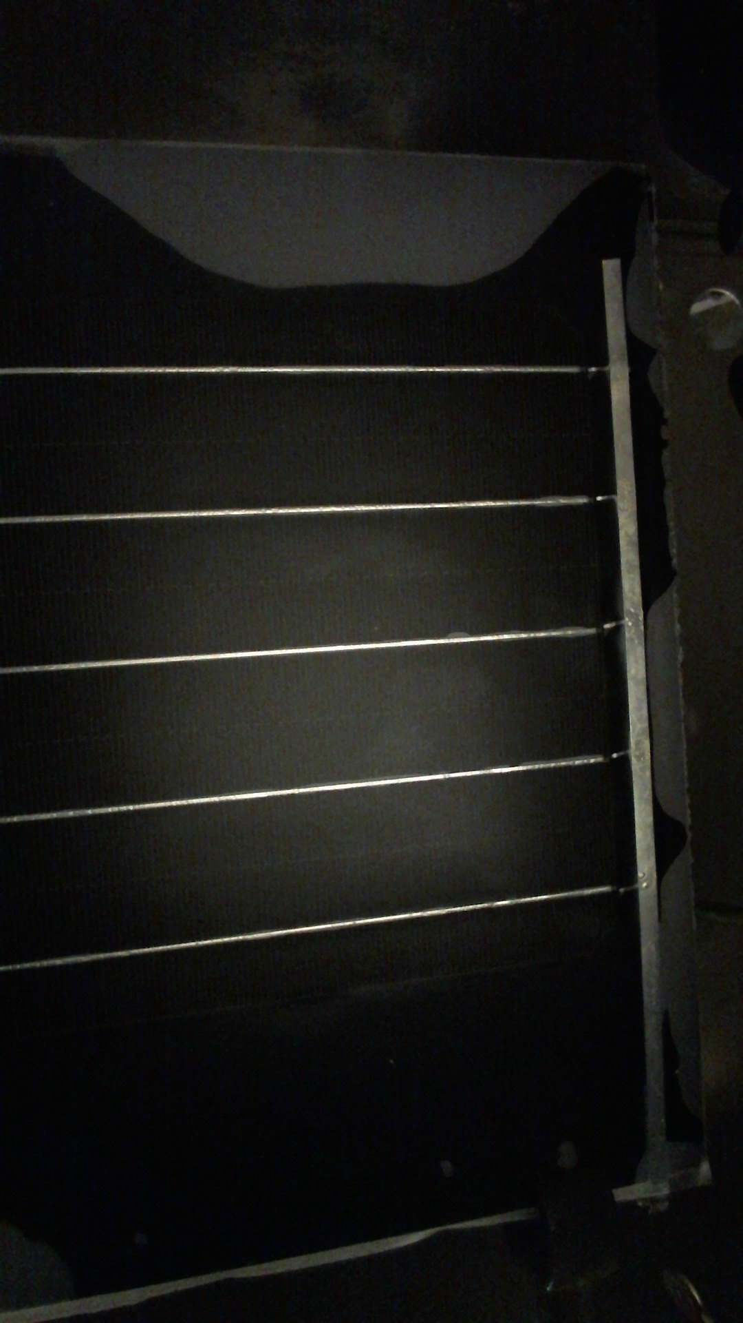
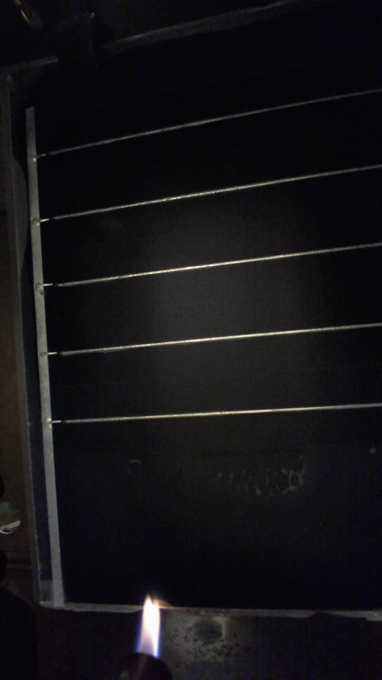
Flame retardant analysis
ETFE
PERC
Encapsulant
Backplane
2 different modules laminated:
Backplane resistant towards fire
No crosslinking-agent
Ref.
FR1

Slide 20
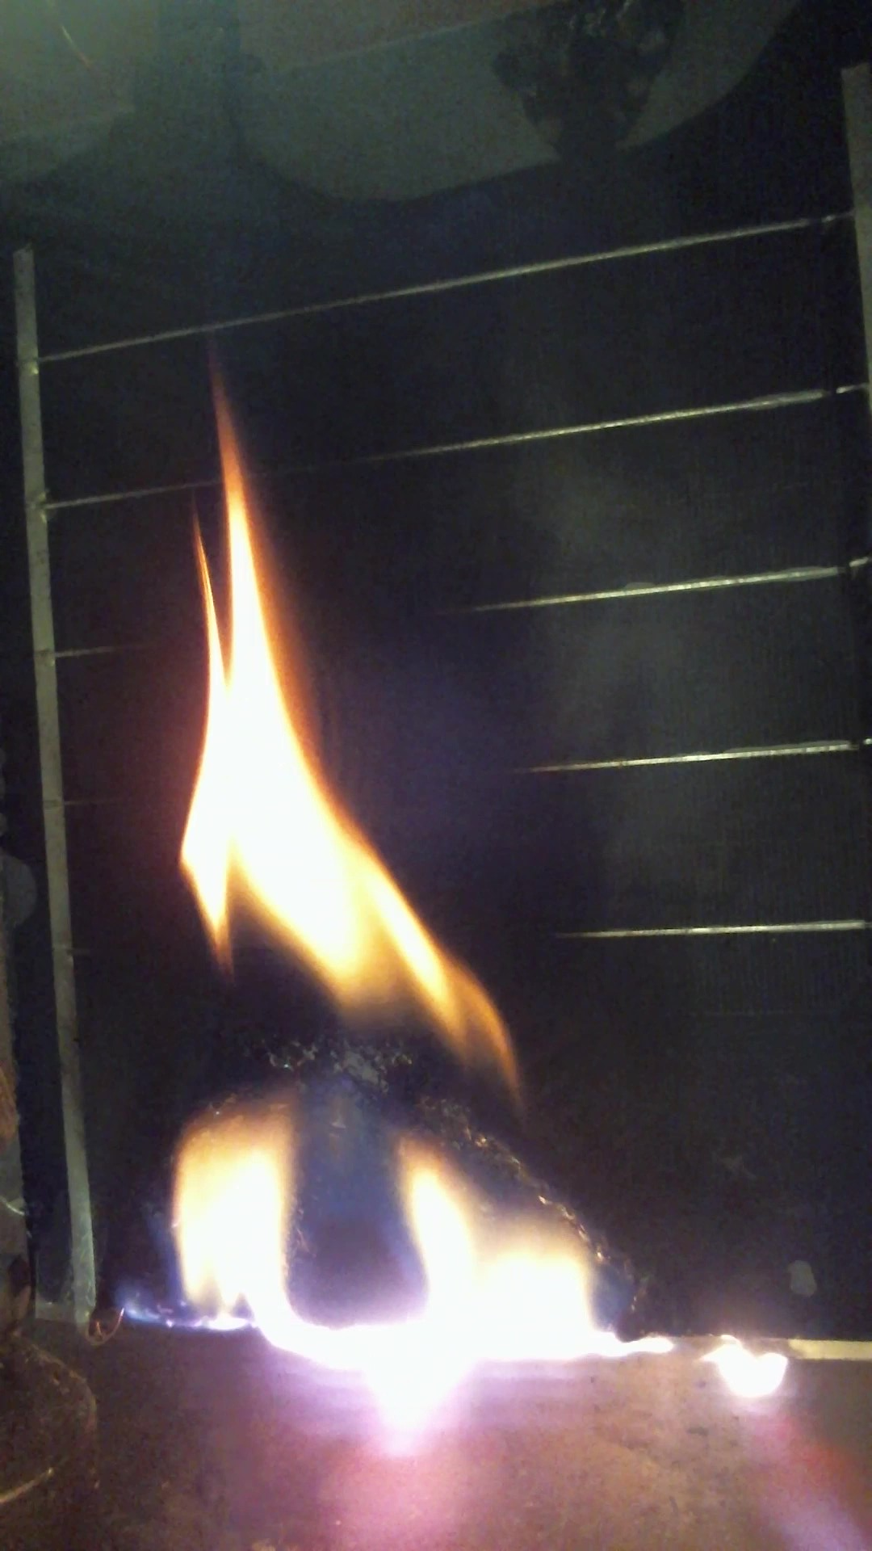
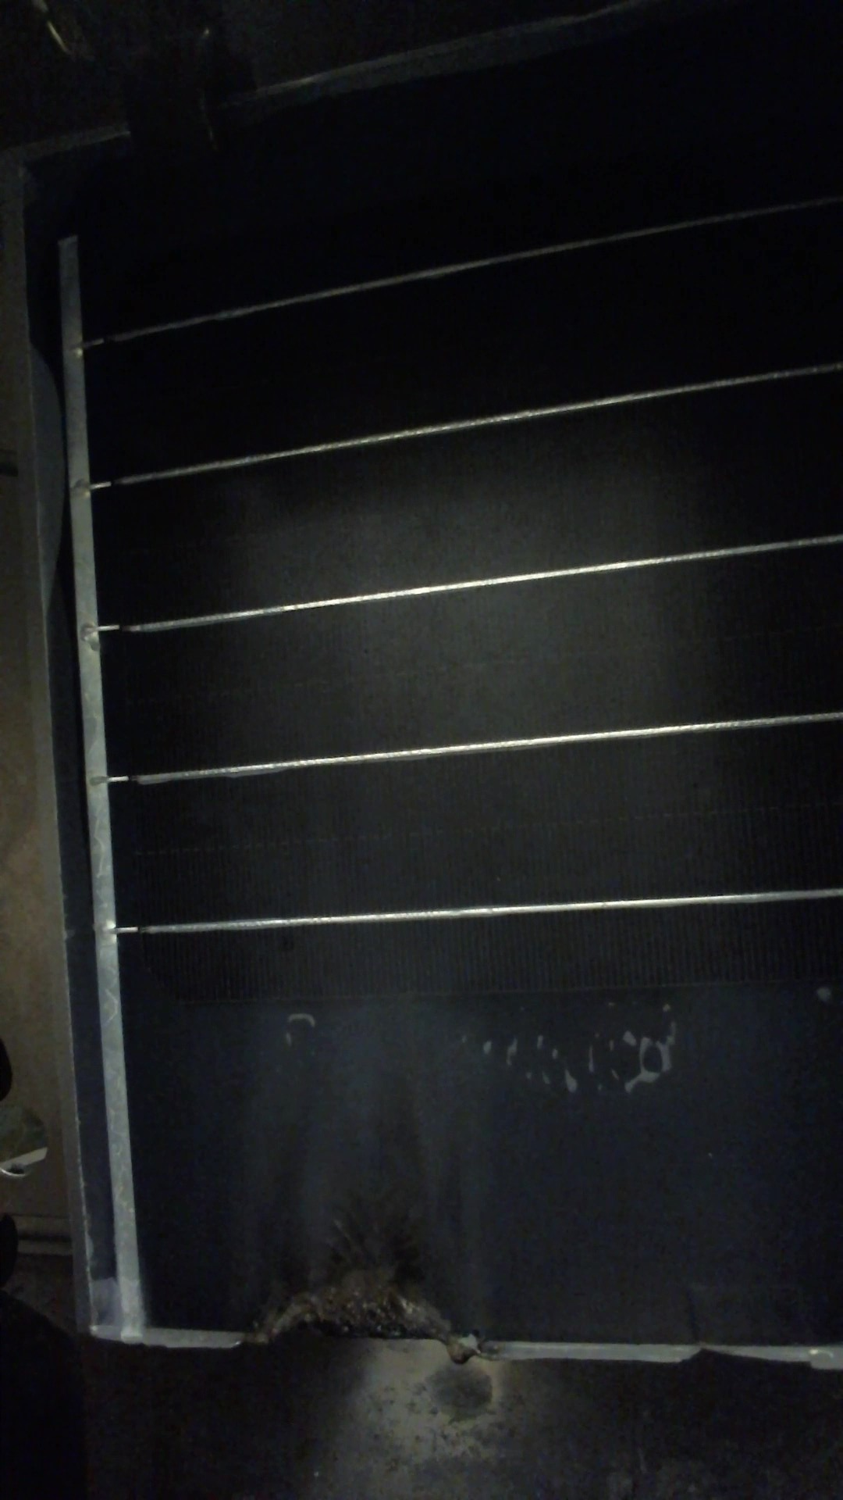
Flame retardant analysis
ETFE
PERC
Encapsulant
Backplane
Ref.
FR1
30s flame exposure
Pictures taken after 2 min 57s
Flame sustained after exposure
Flame stopped 14s after exposure
FR1 addition to encapsulant stops the fire to propagate by itself

Slide 21
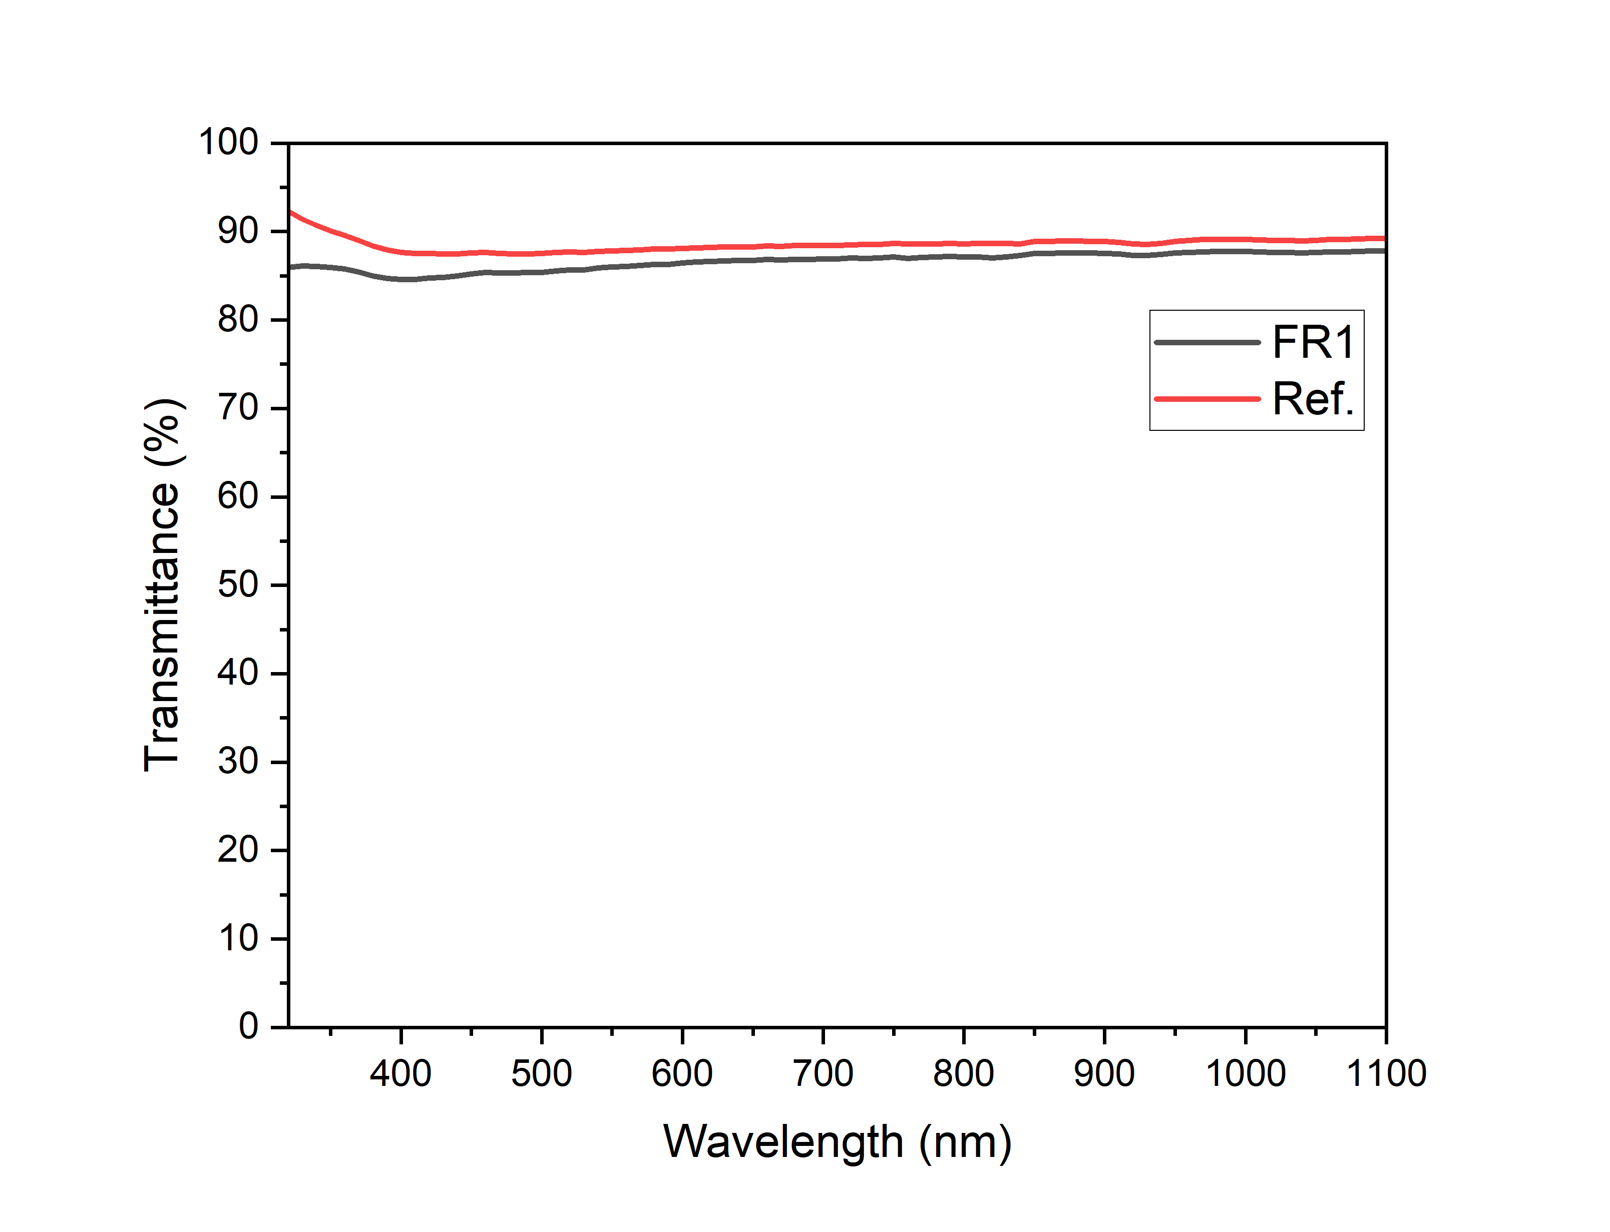
Cell to Module (CTM) loss analysis
Impact of FR1 on the cell performance
Measure I_{SC} before and after lamination.
Ref.
FR1
Before
After
Before
After
Material | Average transmittance 380-1100 nm [%]
Ref | 88.6 ± 0.2
FR1 | 86.9 ± 0.2
CTM loss (%) | -2.3 ± 0.3
CTM loss (%) | -2.6 ± 0.1
Similar CTM loss with or without FR
FR does not affect dramatically performance

Slide 22
Conclusion
PPGF8 polymeric HC selected for the core
FR1 decreases by 30% the flame height of encapsulant
FR1 implementation at the module level improved resistance towards ignition

Slide 23
Future works
In-house instrument improvement
1st round of FR test → much more to come!
Test FR encapsulant mechanical properties

Slide 24
Thank you!
SOPHIA Workshop
Any questions?

Slide 25
Acknowledgment
DELIGHT
Funded in part by DELIGHT project (SOLAR-ERA.NET). This work has received funding by the European Union and by the Swiss State Secretariat for Education, Research and Innovation (SERI) under grant agreements 101136094 (SPHINX project) and 101136112 (INCREASE project).Views and opinions expressed are however those of the author(s) only and do not necessarily reflect those of the European Union. Neither the European Union nor the granting authority can be held responsible for them.​

